Slide 1
2000 Stadium Way
Los Angeles, California
www.barlowhospital.org
TRUSTED  PROVEN  AWARD-WINNING

Slide 2
Introduction
Long-Term Care Hospital (LTCH)
Only not-for-profit in California
Three Locations: Los Angeles Van Nuys Whittier Virtual Video Tour: https://www.barlowhospital.org/locations/
TRUSTED  PROVEN  AWARD-WINNING

Slide 3
Los Angeles
Barlow Respiratory Hospital Historic original location
2000 Stadium Way Los Angeles, CA 90026
Next to Dodger Stadium
Close to downtown Los Angeles
Beautifully landscaped campus adjacent to Elysian Park
Onsite physicians include pulmonologists, critical care, 200+ consulting specialties, access to ICU
Expert care teams include registered nurses, respiratory therapists, rehabilitation professionals (physical therapists, occupational therapists, and speech-language pathologists) clinical dietitians, case managers, licensed social workers, and pharmacists.
TRUSTED  PROVEN  AWARD-WINNING

Slide 4
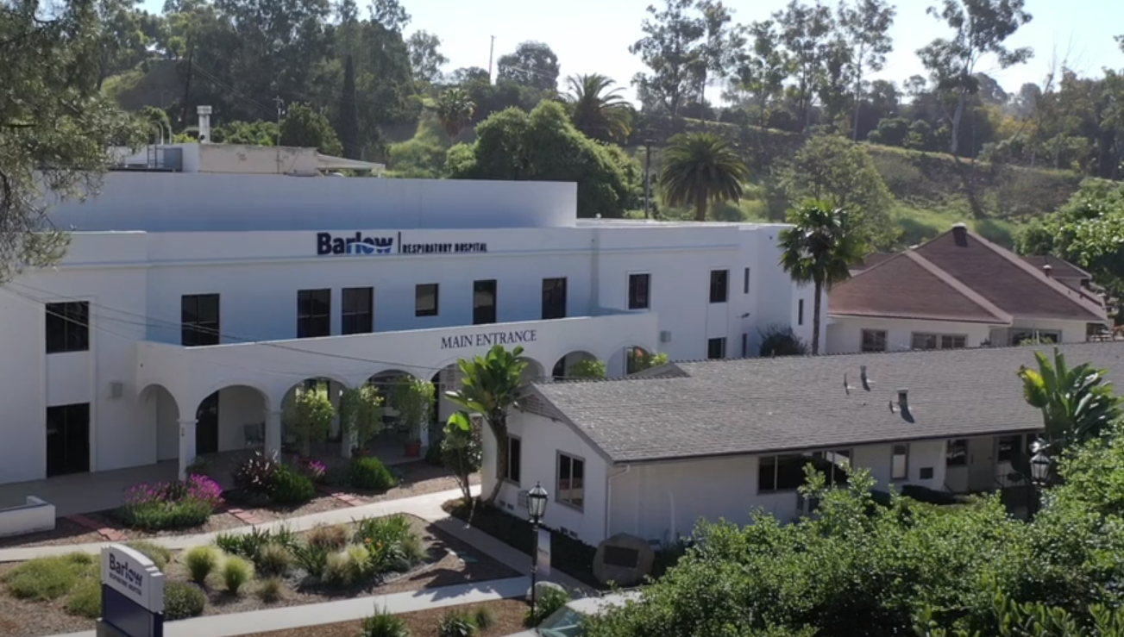
Los Angeles
TRUSTED  PROVEN  AWARD-WINNING

Slide 5
Van Nuys
Barlow Respiratory Hospital at Valley Presbyterian Hospital
15107 Vanowen Street 3rd Floor Van Nuys, CA 91405
Close to 405 Freeway
Hospital-within-a-hospital
Valet Parking available
Onsite physicians include pulmonologists, critical care, 200+ consulting specialties, access to ICU
Expert care teams include registered nurses, respiratory therapists, rehabilitation professionals (physical therapists, occupational therapists, and speech-language pathologists) clinical dietitians, case managers, licensed social workers, and pharmacists.
TRUSTED  PROVEN  AWARD-WINNING

Slide 6
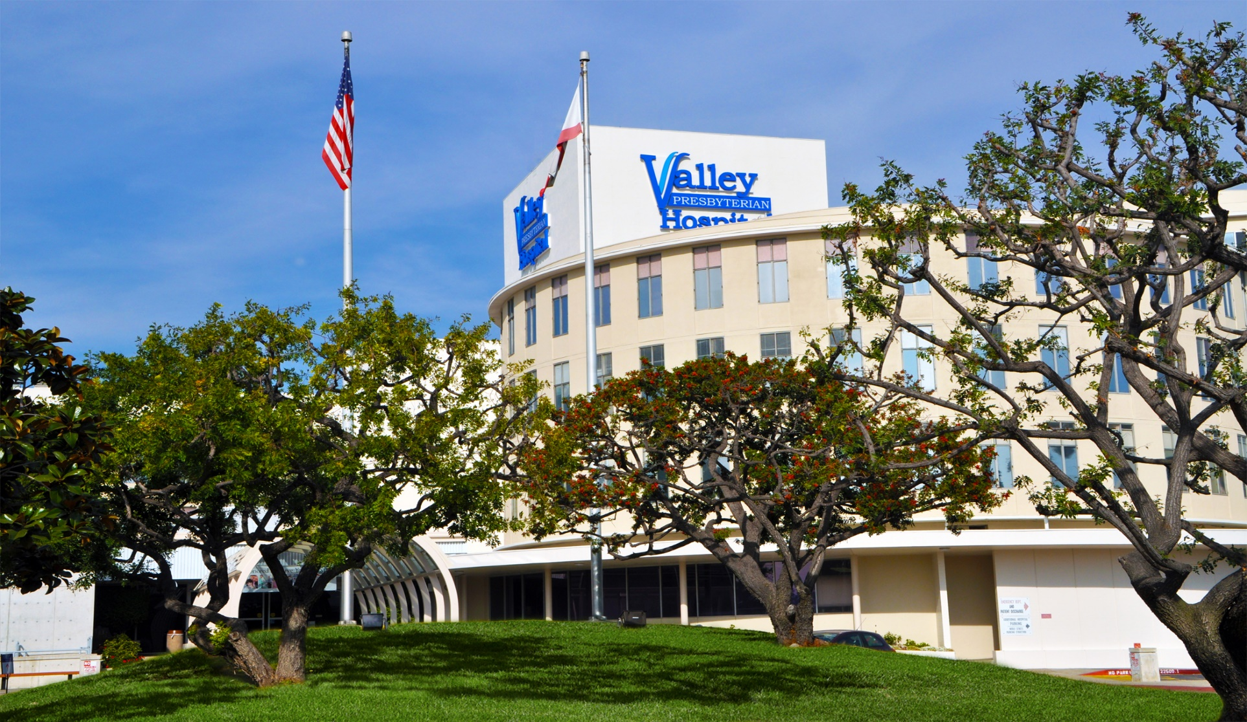
Van Nuys
TRUSTED  PROVEN  AWARD-WINNING

Slide 7
Whittier
Barlow Respiratory Hospital at PIH Health Hospital
12401 E. Washington Blvd 2nd Floor Whittier, CA 90602
Hospital-within-a-hospital
Starbucks Coffee in lobby
Valet parking available
Onsite physicians include pulmonologists, critical care, 200+ consulting specialties, access to ICU
Expert care teams include registered nurses, respiratory therapists, rehabilitation professionals (physical therapists, occupational therapists, and speech-language pathologists) clinical dietitians, case managers, licensed social workers, and pharmacists.
TRUSTED  PROVEN  AWARD-WINNING

Slide 8
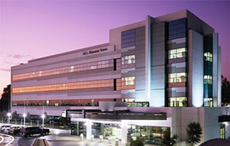
Whittier
TRUSTED  PROVEN  AWARD-WINNING

Slide 9
Ventilator Weaning Program
Who We Are;
Our interdisciplinary clinical team includes:
Physicians
Board Certified Physicians
Physician Specialties (200+)
Registered Nurses
Wound Care Certified (WCC) Registered Nurses
Respiratory Therapy
Physical Therapy
Occupational Therapy
Speech Therapy
Registered Dietitian
Social Workers
Case Managers
Pharmacy
Infection Preventionist
TRUSTED  PROVEN  AWARD-WINNING

Slide 10
Admissions Info 213-202-6878
www.barlowhospital.org

