Slide 1
Innovative Technology for Chronic Disease Management in the Home
Masimo Corporation
Alternate Care

Slide 2
Why We Do What We Do
Section 3025 of the Affordable Care Act added section 1886 to the Social Security Act establishing the Hospital Readmission Reduction Program, which requires CMS to reduce payments to IPPS hospitals with excess readmissions, effective for discharges beginning on October 1, 2012.
Defined readmission as an admission to a subsection (d) hospital within 30 days of a discharge from the same or another subsection (d) hospital

Slide 3
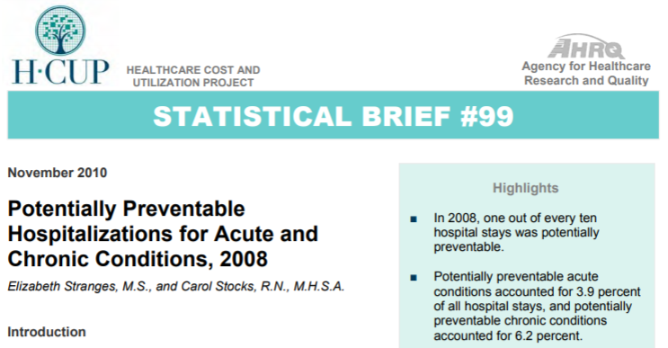
CMS Refined Readmission Target Diagnoses
One in every ten hospital admissions was potentially preventable. Potentially preventable CHRONIC CONDITIONS make up 6.2% of all hospital stays.1
FY 2012
AMI
Heart Failure
Pneumonia
FY 2015
COPD
THA/TKA
1 Agency for Healthcare Research and Quality, Potentially Preventable Hospitalizations for Acute Chronic Conditions, November 2010.
https://www.hcup-us.ahrq.gov/reports/statbriefs/sb99.pdf

Slide 4
COPD Readmission Reduction Strategies
Cross-continuum of care delivery
COPD Coordinator function
Efficient communication between all parties
Seamless discharge
Home visit
Patient centered care
Patient training in self monitoring and self management
Active Lifestyle
Activity supports overall physical and mental health
Patient training
Patient should have a checklist of responsibilities and daily activities
Use of the “teach back” method

Slide 5
COPD Readmission Reduction Strategies
Proper Equipment
MDI
Pulse Ox
Airway clearance devices
Peak flow meters
Rapid Action Plan
Early intervention is the key to successful exacerbation resolution and relapse avoidance
Pulmonary Rehab, smoking cessation
COPD Patient 30 day Hospital Readmission Reduction Program White Paper, Nonin

Slide 6
COPD Readmission Reduction Strategies
Set Clinical Definitions
Chronic Respiratory Failure – inability of the respiratory system to maintain gas exchange within normal limits. The degree of respiratory failure may range from mild to sever with the severity determining the urgency and extant of treatment. It is generally divided into 2 forms:
Oxygenation failure – inability to maintain PaO2 of 60 mm HG or greater on room air.
Ventilatory failure – inability to maintain PaCO2 of 45 mm HG or below
Lets talk oxygenation failure first

Slide 7
Recommendations of the 6th LTOT Consensus Conference
All patients who are provided an intermittent-flow device must be clinically evaluated and titrated to the intermittent flow required by the specific device being employed, in order to ensure optimal oxygen delivery for that individual patient during rest and during routine activities of daily living.
Evidenced based criteria are needed to define “ambulatory”, “portable,” and “wearable” oxygen technologies as they apply to each specific patient’s needs. Until such evidence exists, the physician, patient, and home medical provider must effectively collaborate, using their best efforts and state of the art knowledge in that timeframe to ensure that all LTOT users have access to the best and most appropriate technology that fit their clinical and life style needs

Slide 8
AARC Clinical Practice Guideline for Oxygen in the Home or Alternate Site Health Care Facility
11.1.2 Measurement of baseline oxygen tension and/or saturation is essential before oxygen is begun. These measurements should be repeated when clinically indicated or to follow the course of the disease, as determined by the attending physician. Measurement of oxygen saturation also should be made to determine appropriate oxygen flow or PDOD/DODS setting for ambulation, exercise, or sleep.*
* Includes continuous flow

Slide 9
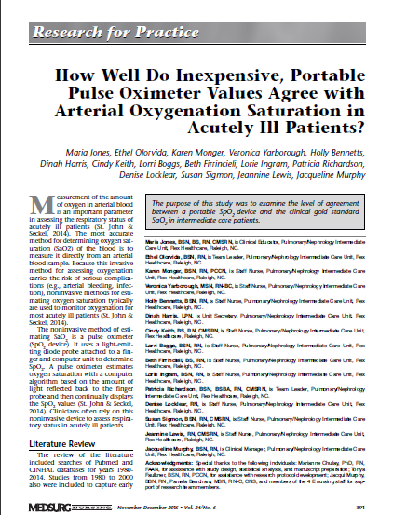
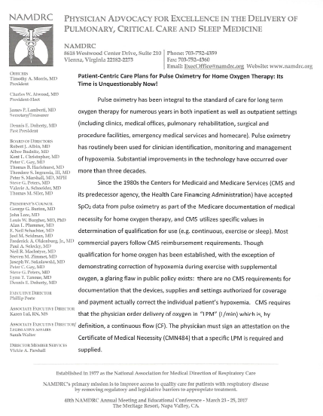
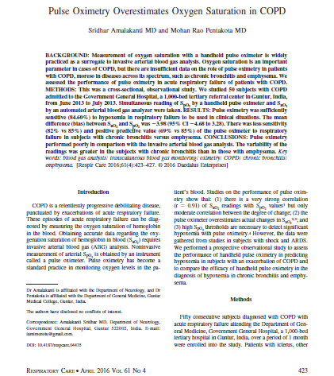
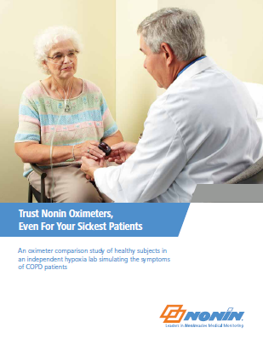
Are All Pulse Oximeters the same? Consider Acutely/Chronically Ill Patients?
Jones Nursing Study
NAMDRC Letter
Pulse Oximetry Overestimates Oxygen Saturation in COPD
Nonin White Paper

Slide 10
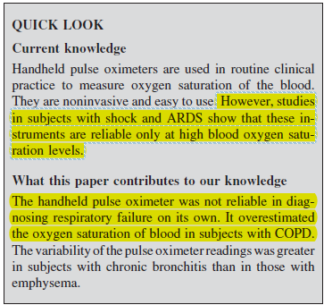
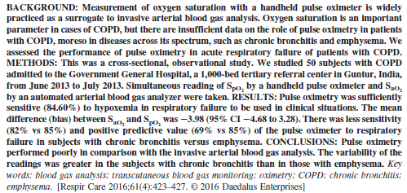
Next Generation Pulse Oximetry on Acutely/Chronically Ill Patients: Pulse Oximetry Overestimates oxygen saturation in COPD Published Respiratory Care Journal, June 2016
Study concluded that CONVENTIONAL “pulse oximetry performed poorly in comparison with the invasive arterial blood gas analysis”. “Variability was greater in those patients with chronic bronchitis.”
Nellcor N-200, discontinued in 1995, was the oximeter used in study. Use of >20 year old technology in study published in 2016 demonstrates the need for education on the value of Next Generation Pulse Oximetry in all care areas.
Performed in India, Published in Respir. Care 2016.

Slide 11
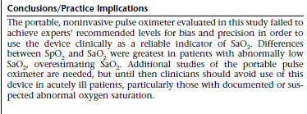
Next Generation Pulse Oximetry on Acutely/Chronically Ill Patients: How well Do Inexpensive, Portable Pulse Oximeter values agree with arterial Oxygenation saturation in acutely ill patients? Published in Medsurg Nursing, Dec 2015
Testing indicated that conventional finger tip pulse oximeters used on acutely ill patients provide inaccurate SpO2 measurements. This type of fingertip pulse oximeter is commonly used in the treatment of COPD patients daily in all care areas.
Is this a practice that we want to continue?

Slide 12
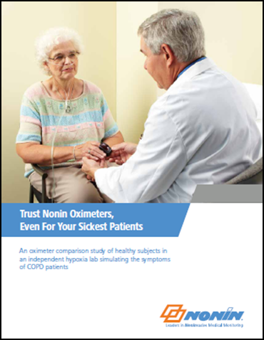
Next Generation Pulse Oximetry on Acutely/Chronically Ill Patients: Nonin White Paper
White paper challenges the performance of the two most common “low cost” finger tip oximeters. Two device makers who represent over 30 different private label finger oximeters sold in the US, both FDA approved and OTC.
“This paper states that when performance might be most needed- during labored breathing with low perfusion - the two low cost oximeters tested in this study failed to track many of the hypoxic events and, instead froze the readings”
“The Oximeters made by Beijing Choice and Contec Medical failed to track many of the desaturations”
Beijing Choice captured 69% of hypoxic events.
Contec captured 21% of hypoxic events
White paper published by Nonin. Performed by Clinimark Labs Boulder, Co.

Slide 13
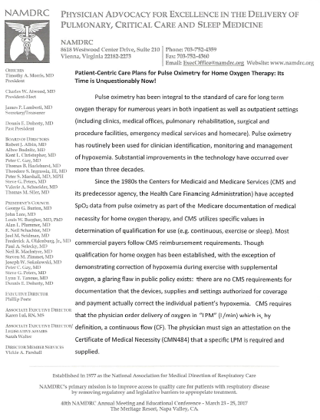
Long Term Oxygen Must be Titrated to Saturation - Consensus Statement …..As of June 2016 from the top Pulmonologists in the US
Patient-Centric Care Plans for Pulse Oximetry for Home Oxygen Therapy:
Its Time is Unquestionably Now!
June 2016,
The National Association of Medical Directors of Respiratory Care

Slide 14
Titrate to Saturate Consensus Statement
“Though qualification for home oxygen has been established, with the exception of demonstrating correction of hypoxemia during exercise with supplemental oxygen, a glaring flaw in public policy exists: there are no CMS requirements for documentation that the devices, supplies, and settings authorized for coverage and payment actually correct the individual patients’ hypoxemia.”

Slide 15
Titrate to Saturate Consensus Statement
“Most portable systems deliver intermittent flow (IF) to conserve oxygen by restricting delivery to inspiration.”
“The IF controllers used with these portable systems have different principals of operation and proprietary designs and there are no standards for the amount of oxygen i.e. liter flow, delivered with IF, thereby making certain elements of the CMS Certificate of Medical Necessity useless and unrelated to actual oxygen usage.”

Slide 16
Titrate to Saturate Consensus Statement
“A prescription for supplementary oxygen for 2 lpm is close to meaningless in the absence of clinical documentation that such flowrate meets the patient’s needs.”
“Establishing liter flow to ensure appropriate oxygen saturation is the standard of care.”

Slide 17
Titrate to Saturate Consensus Statement
“Analogous to diabetes, a pulse oximetry device is a self management tool similar to a glucometer. As with monitoring blood glucose periodically and tied to different activities (before meals and sleep), SpO2 can be monitored periodically and tied to activities (at rest and with different levels of exertion).”

Slide 18
Titrate to Saturate Consensus Statement
“In order to improve outcomes, reduce hospital readmissions, and improve patient quality of life, long term oxygen therapy (LTOT) patients should have their prescribed oxygen titrated to need during rest and activities of daily living (ADLs).”

Slide 19
Titrate to Saturate Consensus Statement
“Only FDA approved devices should be used for oxygen titration.”
“The myriad of non FDA approved devices are not intended or approved for clinical use, and studies have shown them to be inaccurate on sick patients.”

Slide 20
Titrate to Saturate Consensus Statement
“As most oxygen dependent patients are not trained healthcare professionals, it is our recommendation that:
“Only oximeters with 510K clearance that, as a part of the clearance, are tolerant of motion and have adequate performance under normal and low perfusion circumstances should be used to titrate oxygen during activities of daily living.”

Slide 21
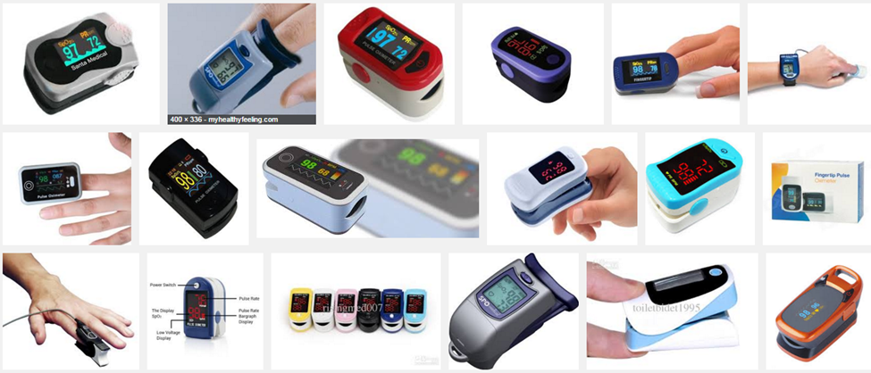
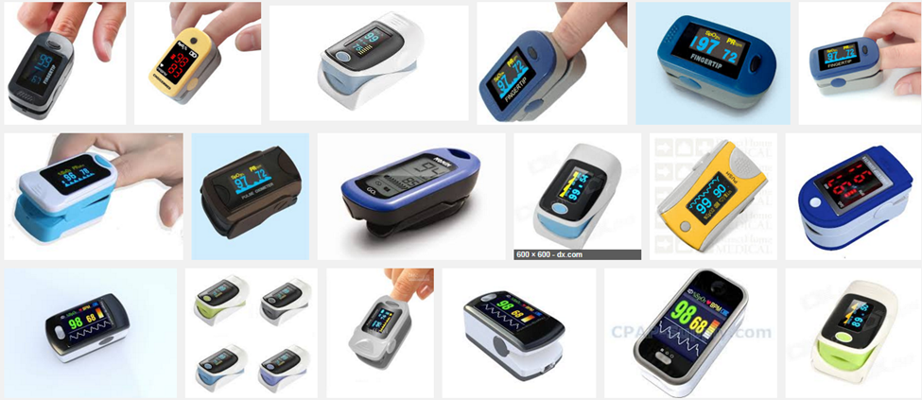
FDA Reviewed, Type II vs OTC Pulse Oximeters
“Only FDA approved devices should be used for Oxygen titration.” -NAMDARC Consensus Statement
Using non FDA approved devices to monitor and titrate O2 settings should not be unacceptable.
OTC pulse oximeters do not have to meet FDA requirements and need not follow any quality standards.
Non FDA approved devices are usually labeled as appropriate for sports and recreation use.
Would you use a non FDA cleared oxygen concentrator to deliver oxygen to your patients?

Slide 22
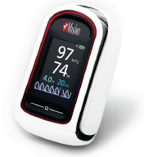
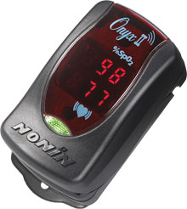
FDA Reviewed Type II Finger Tip oximeters
The following two examples “are tolerant of motion and have adequate performance under normal and low perfusion circumstances.”
Nonin
Several Models
Masimo MightySat

Slide 23
Pulse Oximetry vs. Pulse CO-Oximetry
Pulse Oximetry
2 wavelengths of light
Pulse CO-Oximetry
Multiple wavelengths of light
98%
7 g/dL
+
SpO2
SpHb®
Oxygen Saturation
Supply
Total Hemoglobin Concentration
O₂ Transport Capacity

Slide 24
Definitions
Anemia is a condition of low hemoglobin concentrations caused by decreased production, increased loss, or destruction of RBCs.
The World health Organization (WHO) defines anemia as hemoglobin levels of less than 12 g/dl in women and less than 13 g/dl in men.

Slide 25
Pronto Pulse Co-Oximeter and COPD Readmission
Prevalence of anemia in COPD patients varies from 7.5% - 33%¹
Mortality risk is 34% higher in CHF patients with low Hgb¹
Anemia is a marker for increased morbidity, hospitalizations, length of stay, mortality and health care costs¹
Prolonged anemia has been cited as a contributing factor in the development of left hypertrophy and other co-morbidities²
Wouldn’t O2 therapy be less impactful in patients with low hemoglobin because oxygen carrying capacity is diminished?
Pulse Co-oximetery screening provides noninvasive SpO2, PR and hemoglobin (SpHb), providing clinicians more data to help assess a patients oxygenation status
Source Data: Study of Anemia in Long Term Care (SALT): Prevalence of anemia an its relationship with the risk of falls in nursing home residents.- PNSY
Source data: Falls in people with chronic pulmonary disease; an observational cohort study, Journal of Respiratory Medicine 2011 March; 105(3) 461-469

Slide 26
Prevalence in the Elderly (65 yrs. or >)
In a summary of 45 published studies the weighted mean prevalence of anemia in seniors (65 or>)was found to be:
12% (3-25%) of individuals in the home setting
> 3,000,000 in the US alone¹
23% to 33% of individuals with CHF or COPD¹
35% to 60% of individuals in the LTC setting¹
40% to 72% of individuals at time of hospital admission¹
In a separate study,73% of COPD patients with anemia at time of admission are still anemic at time of discharge²
Dharmarajan, T.S., Avula, S., & Norkus, E.P. (2016, 10). Anemia increases risk for falls in hospitalized older adults: An evaluation of falls in 362
hospitalized, ambulatory, long-term care, and community patients. JAMDA, 7: 287-293.
Silverberg, D.S., Mor, R., & Weu, M.T. (2014). Anemia and iron deficiency in COPD patients: prevalence and the effects of correction of the anemia
with erythropoiesis stimulating agents and intravenous iron. BMC Pulmonary Medicine, 14(24), 1471-2446.

Slide 27
Chronic Anemia
Anemia lasting < 90 days has no statistical impact on hospitalizations
Anemia lasting > 90 days increases your chances of being hospitalized by a factor of 1.9
Anemia lasting 1 year increases your chances of being hospitalized by a factor of 2.2
Dharmarajan, T.S., Avula, S., & Norkus, E.P. (2016, 10). Anemia increases risk for falls in hospitalized older adults: An evaluation of falls in 362
hospitalized, ambulatory, long-term care, and community patients. JAMDA, 7: 287-293.

Slide 28
COPD Comorbidities
Cardiovascular Disease
Hypertension
Diabetes Mellitus
Hypercholesterolemia
Osteoporosis
Mood Disorders (anxiety and depression)
All but the last are causes for anemia of chronic inflammation¹
Yohannes, A.M., & Ershler, W.B. (2011). Anemia in COPD: A systematic review of the prevalence, quality of life, and mortality. Respiratory Care, May, 56(5) 644-652.

Slide 29
Complications Associated with Anemia
Cardiac complications
Cognitive impairment
Depression
Increased mortality
Decreased quality of life
Negative impact on effectiveness on O2 therapy.
Impaired physical performance
Frailty
Falls

Slide 30
Anemia Impact on Patients
Fatigue and dyspnea are the major symptoms of anemia, and these can be related to reduced oxygen carrying capacity of blood¹
Furthermore, this symptom complex in patients with COPD will inevitably contribute the morbidity and mortality associated with impaired quality of life and reduced exercise capacity¹
Annual direct health costs for COPD patients is more than twice as costly with Anemia present ²
$17,240 vs $7,929
Yohannes, A.M., & Ershler, W.B. (2011). Anemia in COPD: A systematic review of the prevalence, quality of life, and mortality. Respiratory Care, May, 56(5) 644-652.
Shorr, A.F. et al.(2008). Anemia in chronic obstructive pulmonary disease: epidemiology and economic implications. Curr Med Resp Opin, April, 24(4), 1123-30.

Slide 31
Impact on NIV survival
In a 2016 cohort study looking at mortality rates for COPD patients in the ICU receiving NIV:
NIV failure rate was over twice as high for anemic vs. patients with normal hemoglobin.
49% vs 22.6%¹
When compared to patients with normal hemoglobin, hospital mortality was higher in the anemic group.
20.8% vs 52.8%¹
What impact can anemia screening have on your NIV program?
1. Ergan, B. & Ergun, R. (2016). Impact of anemia on short-term survival in severe COPD exacerbations: a cohort study. Dovepress, June, 11(1), 1775-83.

Slide 32
Reducing Falls**
In a study of 362 hospitalized ambulatory older adults, patients who fell were more likely to have low hemoglobin.
ER/ICU LOS increased by 2X for patients who suffer a fall.
90% of hip fractures are due to falls and anemic patients are 3 times more likely to have a fall.
Hip fractures projected to increase to 6.3 million annually by 2050.
For each 1 g/dl that hemoglobin increases, risk of fall goes down 24%.
**Source Data: Study of Anemia in Long Term Care (SALT): Prevalence of anemia an its relationship with the risk of falls in nursing home residents.- PNSY

Slide 33
COPD Readmission Reduction Strategies
Would a patient care plan that combined SpO2 and SpHb help better manage the needs of a COPD patient?
Screening for low Hgb in this population makes sense

Slide 34
Pulse Co-Oximetry
Oxygen Saturation (SpO₂) + Total Hemoglobin (SpHb®)
= more information about a patient’s oxygenation status

Slide 35
The Role of SpO2 and SpHb in Oxygenation
In the Blood, Oxygen (O2) binds to Hemoglobin (Hb) for transport to organs in the body.
Consider this example:
Oxygen ( ) are delivered by hemoglobin (Train) to the organ or tissue where they are required (Station)
Hemoglobin has 4 binding sites for oxygen. (Cars on the Train)
SpO2 shows what % of Cars on the Train have a molecule of Oxygen as a passenger
SpHb shows us how many Trains are available, and thus the total Cars are available, to transport the O2.
O₂
O₂
O₂
O₂
O₂
Hb
Tissues & Organs

Slide 36
What SpO2 Tells You About Patient Oxygenation Status
In which scenario below, A or B, is more oxygen being transported to the tissue?
Normal O2 Sat
Almost 95 to 100% of the functional hemoglobin is saturated with oxygen
(95 to 100% of the cars are filled)
A
O₂
O₂
O₂
O₂
O₂
O₂
O₂
O₂
O₂
O₂
O₂
O₂
Hb
Hb
Hb
Low O2 Sat
Oxygen delivery to the tissue is reduced. In this example, the SpO2 would be 50%.
B
O₂
O₂
O₂
O₂
O₂
O₂
Hb
Hb
Hb
Pulse oximetry indicates what % of hemoglobin binding sites are carrying oxygen.
This provides insight into how efficiently the body is getting oxygen to the organs & tissues.

Slide 37
What SpHb Adds to the Picture of Oxygenation Status
A higher hemoglobin concentration means more “carrying capacity to get oxygen to the body. (e.g. More trains and cars to carry the O2)
Normal SpHb
Plenty of binding sites for oxygen in the blood. (Plenty of Trains)
A lower hemoglobin concentration means less binding sites to transport oxygen to the body. (Fewer trains to carry the O2)
Low SpHb (Anemia)
Oxygen delivery to the tissue is inhibited by low Hemoglobin. (Fewer Trains)
The SpO2 in both of the above examples is the SAME (100%).
However, the patient with lower hemoglobin has less oxygen carrying capacity.

Slide 38
Low SpO2 and Low SpHb
The combination of low hemoglobin and decreased oxygen can result in a very low oxygen content which may be apparent in the following patients:
Chronic Obstructive Pulmonary Disease
Congestive Heart Failure
Other Chronic Diseases
Asthma
Obstructive Sleep Apnea
Obesity
Geriatrics
Pregnant women
O₂
O₂
O₂
Hb
Hb

Slide 39
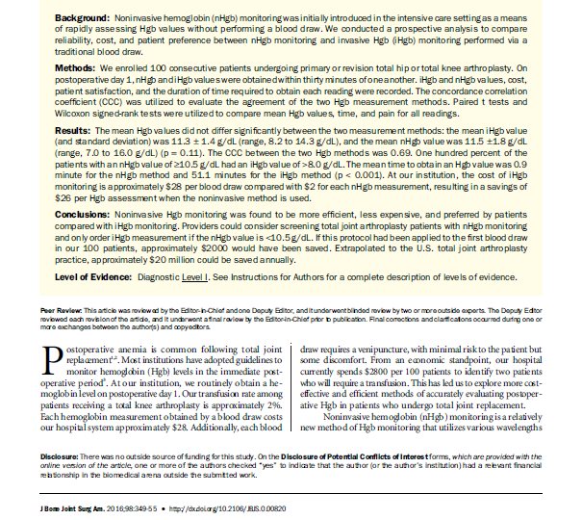
Suggested Support Document for Screening Post Surgery with Pulse Co-OximetrY: Noninvasive Hemoglobin Monitoring, a rapid, reliable, and cost-effective method following total joint replacement Mayo Study Published in Journal of Bone and Joint Surgery, 2016
Study performed by Mayo used non invasive hemoglobin for screening post total hip and total knee surgery results were favorable for nHgb.
Researchers said:
“Hgb monitoring was found to be more efficient, less expensive, and preferred by patients compared to iHgb monitoring (invasive testing)”
“ Implementation of this screening protocol following total hip and total knee arthroplasty could eliminate the need for invasive monitoring iHgb in approximately 80% of patients, resulting in potential annual savings of more than twenty million dollars in the US alone.

Slide 40
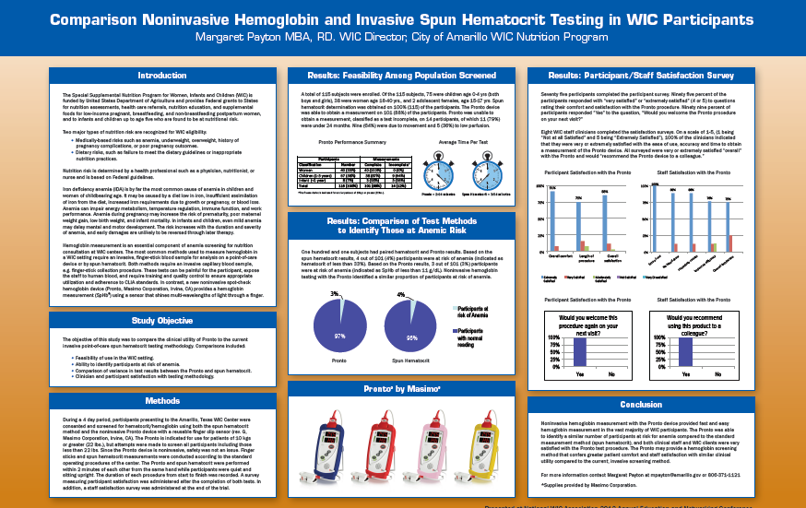
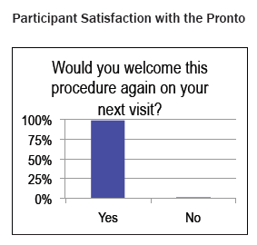
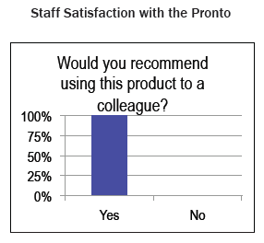
Suggested Support Document for Screening with Pulse Co-OximetrY: Lubbock, TX WIC Poster Presentation
From Conclusion:
“Noninvasive hemoglobin measurement with the Pronto device provided fast and easy hemoglobin measurement in the vast majority of WIC participants.”
“Pronto may provide a hemoglobin screening method that confers greater patient comfort an staff satisfaction with similar clinical utility compared to the current, invasive screening method.”

Slide 41
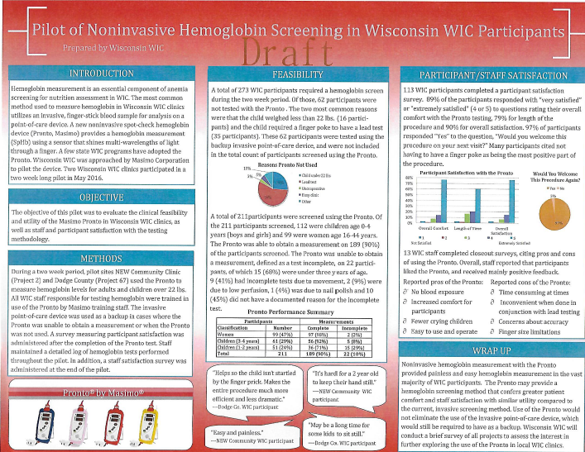
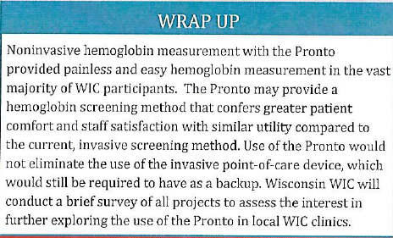
Suggested Support Document for Screening with Pulse Co-OximetrY: Wisconsin, WIC Poster Presentation
Pronto Performance Summary
3 Wisconsin WIC Clinics. 211 clients.
Pronto successfully obtained a measurement on 90% of clients.
Pronto successfully obtained a measurement on 96.68% of clients age 3 and above.
Staff satisfaction was high
97% of Clients surveyed said they would welcome this method of assessment again on the next visit.

Slide 42
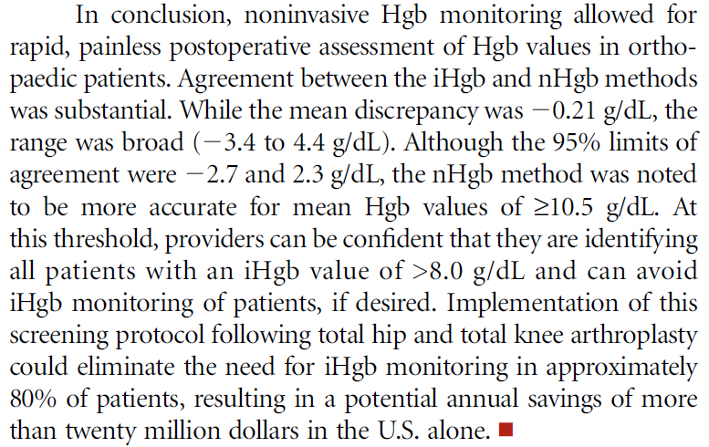
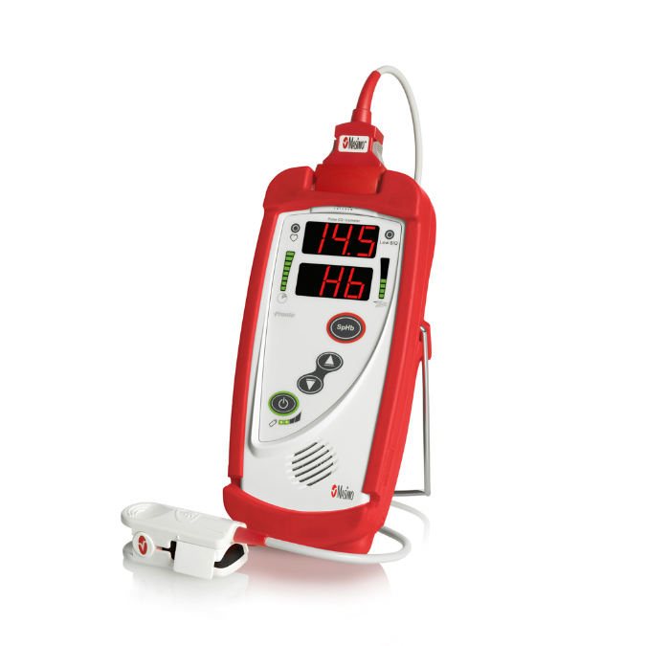
Pronto® Pulse CO-Oximeter ® Upgrade Your Pulse Oximeter
Pronto® provides more information about your patient’s oxygenation by noninvasively and simultaneously measuring oxygen saturation (SpO2), pulse rate (PR) and total hemoglobin (SpHb®) facilitating timely patient assessment and reducing unnecessary testing.

Slide 43
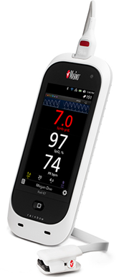
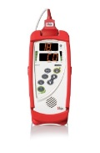
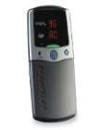
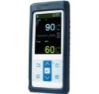
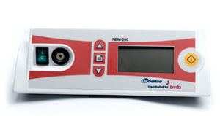
Evolution: Conventional…. to Next Generation…. to Pulse CO-Oximetry
Pulse Co-Oximetry
Next Generation
Rad-57®
Oxygenation Status Visibility
Confidence with Acute & Chronic illness
MORE Info on
Oxygenation Status
Conventional
Rad-5/5v®
Mighty Sat®
Confidence with Acute & chronic illness
Nonin
OrSense
Choice
Nellcor
Pulse Oximetry
2 Wavelengths of Light
Pulse CO-Oximetry
Multiple Wavelengths of Light
Technology Advancements

Slide 44
Conventional to Next Generation Next Generation Pulse Oximetry, essential with Acutely and Chronically Ill Patients
All oximeters are not the same – Next Generation technology is superior to conventional and imports especially with sick patients
Using Pulse Co-oximetry to non invasively add SpHb screening to a vital signs assessment may help clinicians get a better picture of oxygenation status
As acuity levels go up in the home and LTC’s. The ability to efficiently gather more information at the point of care can aid in improving patient care and possibly a re-admission reduction program

Slide 45
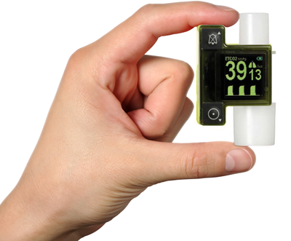
EMMA Capnograph
The Other Half of the Equation

Slide 46
Reimbursement and Audits
Choice of an appropriate treatment plan, including determination to use a ventilator vs. a bilevel PAP device, is made upon the specifics of each beneficiary’s medical condition. In the event of a claim review, there must be sufficient detailed information in the medical record to justify the treatment selected.*
Correct Coding and Coverage of ventilators-Revised May 2016, Joint DME Publication

Slide 47
Spot Check EtCO2 & Respiratory Rate Measurements
The purpose of NIV is to arrest or reverse the elevated levels of CO2 in the blood.
Respiratory Rate is a primary indicator of respiratory status and helps in evaluating efficacy of NIV therapy
Spot check EtCo2 measurements also help in evaluating the efficacy of therapy
Perform at same time of day
Prevent leaks
Nose clips, hands around lips, etc…
Would having proof of usage and efficacy of therapy be beneficial in case of an audit?

Slide 48
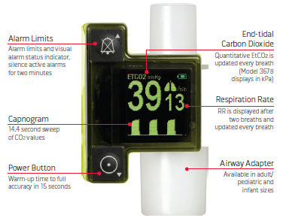
EMMATM User Interface

Slide 49
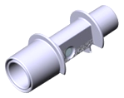
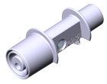
EMMATM Airway Adapter
The EMMA Airway Adapter is intended for single patient use
Two models
Adult/Pediatric
Dead space 6ml
Flow resistance <0.3 cm H2O at 30 Lpm
Infant
Dead space 1 ml
Flow resistance <1.3 cm H2O at 10 Lpm

Slide 50
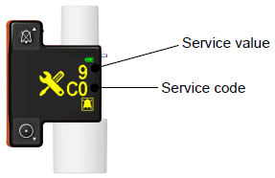
Zeroing procedure
Press Power On button.
Attach EMMA Airway Adapter
Ambient air (0% CO2) in the EMMA Airway Adapter is crucial
Press and keep holding down simultaneously Power On button and Alarm Silence button
Once the Service value display “0”, Zeroing of EMMA is completed.
Service value starts "counting down" i.e. displaying "9" - "8" - "7" etc. until "0" is displayed.

