Slide 1
8. Seasonal Respiratory Infections
The Common Cold
Influenza
Alan F. Rothfeld, M. D.

Slide 2
Questions
Why are respiratory infections seasonal?
Why can’t we cure the common cold?
Should I get a flu shot?

Slide 3
Reasons for Physician Visits (U.S.) Adults, million visits
cough 22.4
sore throat 17.5
skin rash 13.5
vision 13.0
knee 12.5
back 12.5
stomach 12.3
earache 11.3
hypertension 10.4 (most common disease 35 m)
depression 10.0

Slide 4
Reasons for Physician Visits (U.S.) Children, Visits per Year
Colds 5-10 times per year
Coughs 4-5 times per year
Croup 1-2 times per year
Sore throat 4-5 times per year, mostly with colds, occasionally with Strep
Eyes with pus or drainage 1-2 times per year
Earache 1-2 times per year
Diarrhea 3-4 times per year
Vomiting 1-2 times per year
Wheezing: 50% of infants experience wheezing during a viral respiratory infection (called bronchiolitis). Of these, 1/3 wheeze once, 1/3 have 1 or 2 recurrences, and 1/3 go on to develop asthma.
Fever 5-10 times per year with the above symptoms/infections; 1-2 times per year without any other symptoms

Slide 5
“We can put a man on the moon, but we have no idea how to treat the common cold…”
Why?
-G. McGovern

Slide 6
Why Are Respiratory Infections Seasonal?

Slide 7
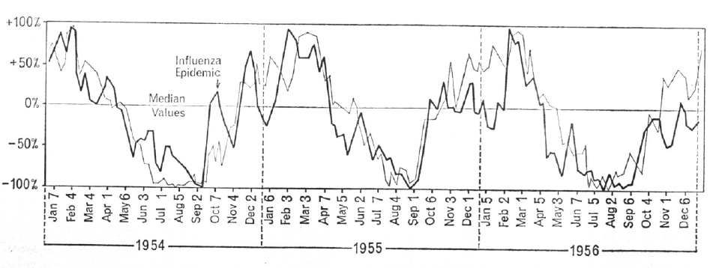
Colds and Temperature

Slide 8
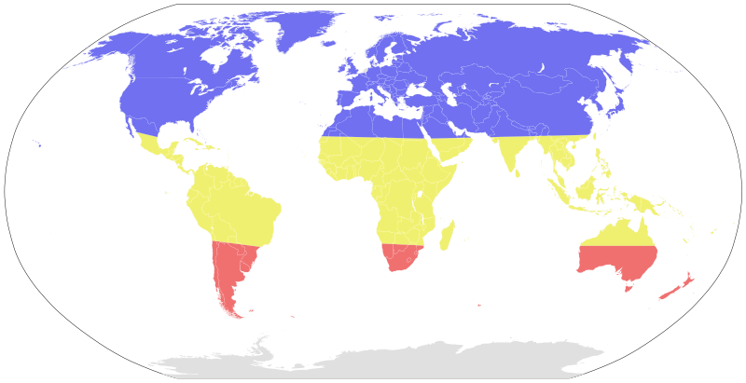
Seasonal risk areas for influenza November–April (blue) April–November (red) year-round (yellow)

Slide 9
Causes of Upper Respiratory Infections
Etiology | Types | %
Rhinovirus | 120+ | 30 | hand to eye
Coronavirus | 5+ | 13 | aerosol
Syncytial | 1
Parainfluenza | 4
Adenovirus | 33 | 13
Enterovirus | 60+
Reovirus | 3
other viruses |  | 35
bacteria |  | 7
Influenza | 3 | 2(0-90%) | aerosol

Slide 10
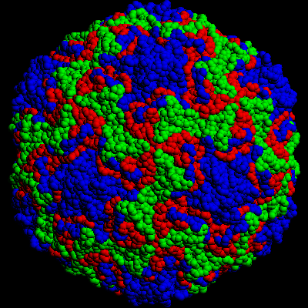
Rhinovirus 16
as resolved with x-ray crystallography
(color-coded proteins)
Can reproduce only between 33-34°C
Single stranded RNA

Slide 11
The Respiratory Virus Cycle
viral factors
genetic novelty
climate/weather
host factors
source responsiveness
activity
social factors
population density
mixing
animal husbandry
contact customs
viral factors
invasiveness (“energy”)
temperature tolerance
built in limits
host defenses
prior exposure (antibodies)
day length, sunlight
sleep
drugs
Acquisition
Disease

Slide 12
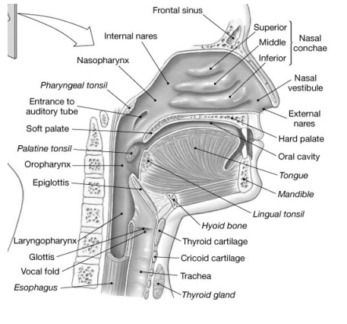

Slide 13
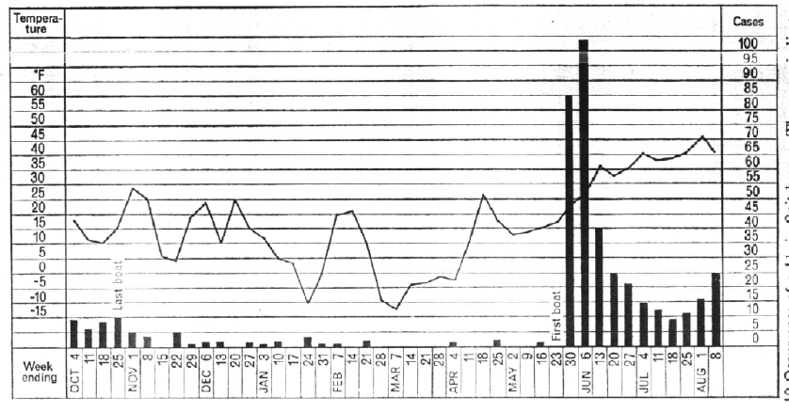
Colds, Temperature, and Contact

Slide 14
Vertebrates as Viral Chauffeurs
Over 100 distinct types of virus cause colds
Cold viruses disappear soon after the onset of symptoms
Cold viruses do not invade
Induced Symptoms are designed to spread the virus
Convenient attachment locale
The disease is the defense
Carefully modulated severity

Slide 15
Cures for the Common Cold
1. Kill the virus
Rhinoviruses cannot survive at >37ºC
Steam inhalation
Zinc kills effectively
Jackson, Arch Int Med 1997;157:2373
Interferon α and β
Farr, Antimicrob Agents Chemother 1984;26:31
Sperber, J Infect Dis 1989;160:700
Ribavirin
Dolovich, Chest 1992;102:284
Dichloroflavan
Phillpotts, Arch Virol 1983;75:115
Pirodavir
Hayden, Antimicrob Agents Chemother 1995;39:290
2. Prevent adhesion
ICAM-1
Huguenel, Am J Resp Crit Care Med 1997;155:1206

Slide 16
3. Prevent the response
Steroids
NSAIDs
Anticholinergics (nasal Atrovent)
Antihistamines
α Adrenergic agents (phenylepinepherine, Afrin)
Expectorants, suppressants
Nausea and narcosis
4. Prevent spread
Nasal iodine
Wash hands compulsively
No handshaking

Slide 17
5. Magic
The chicken soup legacy
Chicken Soup Inhibits Neutrophil Chemotaxis In Vitro. Rennard, Chest 2000;118:1150
Saketkhoo K, Effects of drinking hot water, cold water and chicken soup on nasal mucus velocity and nasal airflow resistance. Chest 1978; 74:408
Vitamin C
The Nobel Cult of Linus Pauling
Ginsana G
Antibiotics
~25% of all antibiotic prescriptions
Echinacea

Slide 18
Drugs and Respiratory Illnesses
DEFENSE | ACTION | SUPPRESSION | EFFECT
fever | viral kill | antipyretics | ↑virulence
cilia | clear bacteria | narcotics antihistamines sedatives | impaired bacterial and irritant clearance
cough | airway clearance | narcotics | pneumonia
mucus | block penetration, antibodies | antihistamines decongestants | prolonged disease
bacteria | kill pathogens | inappropriate antibiotics | bacterial pneumonia

Slide 19
So Why Can’t We Cure the Common Cold?
Killing the virus is not feasible
Complexity through simplicity
Very poor antigenicity
Hit and Run
Viruses are largely gone when symptoms become prominent
Symptoms are the response, not the infection
Prevention of Spread theoretically possible
drug therapy likely limited to symptomatic
Walking the tightrope

Slide 20
Where Should I Invest Money for the Common Cold?
Cures for the Common Cold
120-valent inhaled vaccine?
A Common rhinovirus protein antibody?
Change the irritant receptor biology?
Invest in antiviral environmental surfaces?
Sell PR to the government
Make handwashing easy and socially desirable
Fashion
Cool wash stations?
Advertising
Obsoleting the handshake?

Slide 21
Influenza

Slide 22
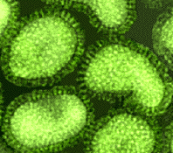
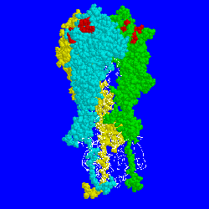
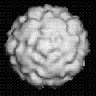
The Influenza A Virus
hemaglutinin
Rhinovirus 16

Slide 23
Influenza vs Cold Symptoms
Onset Sudden Gradual
Fever Characteristic, high (over Rare 101°F); lasting 3 to 4 days
Cough Nonproductive; can Hacking become severe
Headache Prominent Rare
Myalgia (aches and pains) Usual; often severe Slight
Fatigue; weakness Can last up to 2 to 3 weeks Very mild
Extreme exhaustion Early and prominent Never
Chest discomfort Common Mild moderate
Stuffy nose Sometimes Common
Sneezing Sometimes Usual
Sore throat Sometimes Common
Signs & Symptoms Influenza Cold
Adapted from the National Institute of Allergy and Infectious Diseases.
Notes:
One of the most common diagnostic challenges in every flu season is differentiating influenza from the common cold. In general, patients with colds are more likely to report gradual onset of stuffy noses, sneezing and sore throats, while sudden onset and severe, persistent constitutional symptoms tend to predominate in persons with influenza.¹¹
Slide 10
Lecture Notes

Slide 24
Pneumonia and Influenza Mortality Rates by Age
Per 10,000
<5
5-9
10-14
15-19
20-24
25-34
35-44
45-54
55-64
≥65
Age (yr)
Glezen WP. Epidemiol Rev. 1996;18:73
Notes:
As will be discussed further (see slide 9), influenza infection occurs in every age group across the entire population.⁶ The majority of pneumonia and influenza deaths occur in the elderly, who are less likely to survive the cardiopulmonary complications of the disease.
Slide 3
Lecture Notes

Slide 25
Secondary Complications of Influenza
Southwestern US Health Plan Study
30
27
22
18
Complications/1,000 Events
9
Synergy Health Care, Inc. data
Notes:
Much of the morbidity and mortality associated with influenza infection occurs not because of the disease per se but because of its cardiopulmonary and upper respiratory complications. These include:
Sinusitis
Bronchitis
Otitis media
Viral and/or bacterial pneumonia, typically caused by S pneumoniae, S aureus, or H influenzae
Rhinitis
The incidence of complications shown here comes from the study of a southwestern US health plan of about 270,000 patients during the period October 1994 through September 1996. The age and gender distributions reflect those of a standard commercial health insurer.
It is difficult to determine the incidence of increases in underlying illness due to influenza, such as COPD, asthma, and CHF. However, among those complications that are measurable, sinusitis appears to have the largest incidence, followed by bronchitis. Otitis media is seen more in the pediatric population, while pneumonia is more often seen in the elderly.
Slide 4
Lecture Notes

Slide 26
Influenza Surface Proteins
Neuraminidase
Hemagglutinin
RNA
M₂ protein
(only on type A)
Notes:
Two glycoproteins jut out from the surface of the influenza virus: hemagglutinin (HA) and neuraminidase (NA). Both of these antigenic surface proteins play key roles in viral infection and dissemination.
Slide 11
Lecture Notes

Slide 27
Clinically Relevant Influenza Viruses
Type A Potentially severe illness
Epidemics and pandemics
Rapidly changing
Type B Usually less severe illness
Epidemics
More uniform
Type C Usually mild or asymptomatic illness
Minimal public health impact
Centers for Disease Control and Prevention. Influenza Prevention and Control. Influenza. Available at: http://www.cdc.gov/ncidod/diseases/flu/fluinfo.htm.
Notes:
Influenza is caused by viruses belonging to the Orthomyxoviridae family. The viruses are further classified according to the differing composition of their nuclear proteins into three types: type A, type B, and type C. Each type is associated with a different clinical and epidemiological profile.
Influenza type A viruses cause potentially severe illness. Because they can change rapidly, type A viruses are responsible not only for epidemic but also pandemic infections that have swept the globe throughout this past century. This type of virus infects both humans and animals.
Influenza type B viruses are more uniform than type A viruses. They infect only humans and usually produce less severe clinical illness than that associated with type A infections. However, type B viruses have been associated with epidemic infections that cause widespread hospitalization and death. Because they do not circulate in animals, interspecies antigenic shifts do not occur with influenza type B viruses and do not produce pandemic infection.¹³
The influenza type C virus usually causes only mild, if not asymptomatic, infection. Its impact on public health is minimal.¹³
Slide 10
Lecture Notes

Slide 28
A Constantly Mutating Virus
Type B
Type A
H1N1
H2N2
H3N2
H5N1
Notes:
Both neuraminidase and hemagglutinin undergo constant mutations in their amino acid sequencing. These antigenic changes give rise to newly evolved strains of influenza virus that often confound the efficacy of influenza vaccines prepared from existing viruses and create resistance to currently used antiviral therapies such as amantadine and rimantadine.¹ In order to be effective against a continually changing virus, an antiviral agent must therefore target a conserved site on the influenza virus, ie, one containing a configuration of amino acids that remains constant across all strains.
Ongoing change caused by antigenic drift requires ongoing reformulation of influenza vaccines. When there is significant antigenic drift of hemagglutinin, vaccines are less effective.¹ Although there can be a slight drift with neuraminidase, the active site of that enzyme appears to be well conserved, and when it does drift, the ability of influenza virus to infect other cells seems to be impaired.¹
Slide 6
Lecture Notes

Slide 29
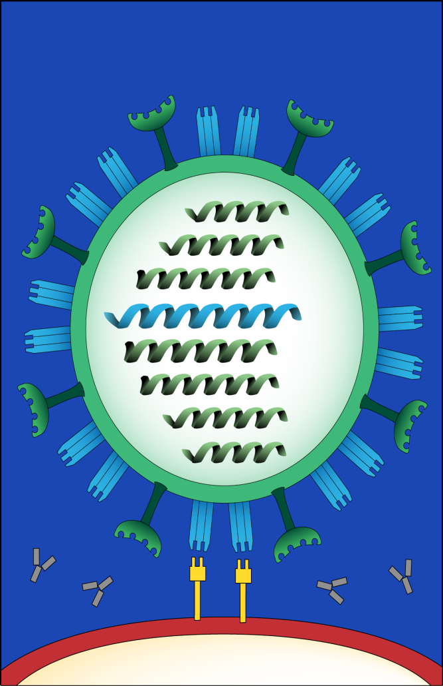
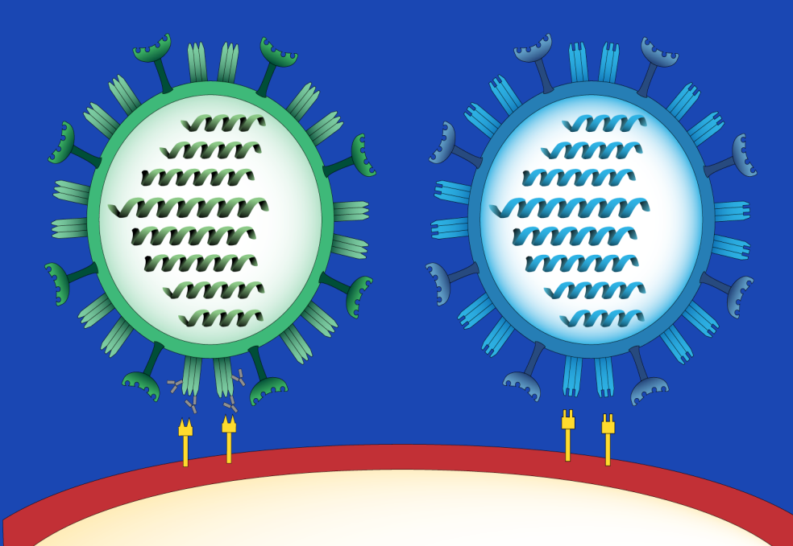
Antigenic Shift
Notes:
In contrast to the gradual evolution of strains subject to antigenic drift, antigenic shift occurs as soon as a type A influenza virus with a completely novel hemagglutinin or neuraminidase formation moves into humans from other host species. The primary source is birds, certain species of which carry a reservoir of 15 influenza A subtypes.¹⁶ These subtypes either genetically reassort themselves with circulating human influenza virus or are transmitted directly into humans, typically via intermediate hosts such as swine.¹⁵
Antigenic shift of type A influenza viruses occurs less frequently than antigenic drift, but with more dramatic impact. The result of global immunologic susceptibility to a new influenza virus is often pandemic. The influenza pandemics of both 1957 and 1968, for example, were caused by genetic reassortment between human and avian influenza A virus.¹⁶
To date, influenza type B viruses have not been subject to antigenic shift.¹⁵
Slide 16
Lecture Notes

Slide 30
Natural History of Influenza Viruses
Serum antibody prevalence
Virus isolation
B
H3N8
H3N2
H2N?
H2N2
H1N1
H1N1
1880
1890
1900
1910
1920
1930
1940
1950
1960
1970
1980
1990
2000
Topley and Wilson’s Microbiology and Microbial Infections. 9th ed, Vol 1, Virology. Mahy and Collier, eds, 1998, Arnold, page 387, with permission.
Notes:
This chart illustrates the natural history of human influenza viruses over the past century.²⁰ One type B and two type A influenza strains are currently circulating around the world. The latter include type A (H1N1) and type A (H3N2).
Slide 19
Lecture Notes

Slide 31
Occurrence of Influenza Pandemics and Epidemics
Incidence of clinically manifest influenza
Mean level of population antibody vs A HxNx
Mean level of population antibody vs A HyNy
Pandemic
Pandemic
Interpandemic Period
Disease Incidence
Epidemic
Epidemic
Mean Population Antibody Level
Epidemic
1
2
3
4
5
6
7
8
9
10
11
12
Time in Years
Introduction of
hypothetical
A HxNx virus
Significant minor variation A HxNx may occur at any
of these points. Epidemics may or may not be
associated with such variations
Introduction of hypothetical
A HyNy major (new subtype)
variant A HxNx disappears
Mandell, Douglas and Bennett’s Principles and Practice of Infectious Diseases, 5th ed. 2000:1829. Modified from Kilbourne ED. Influenza. 1987:274
Notes:
Here’s how cycles of antigenic shifts and antigenic drifts translate into cycles of epidemics and pandemics.
A new virus (shown here as Type A HxNx) is introduced to a population that has no antibodies against it.¹⁷ The result is widespread infection throughout the world, or a pandemic. After widespread exposure to the virus, however, antibody formation increases. Increased immunity applies evolutionary pressures to the virus, which can respond with the formation of variant strains, ie, antigenic drift. If these slightly different strains have the “right” degree of transmissibility, they can cause repeated epidemics, each of which increases the level of immunity among the population.
After about 10 years, the population as a whole develops widespread immunity to the virus. Once again, selection pressures make the environment especially ripe for the spread of an entirely new virus, perhaps one introduced by genetic reassortment or antigenic shift. This new virus (shown here as Type A HyNy) spreads through a population that has no immunologic protection against it. Once again, the result is pandemic infection.¹⁷
Slide 17
Lecture Notes

Slide 32
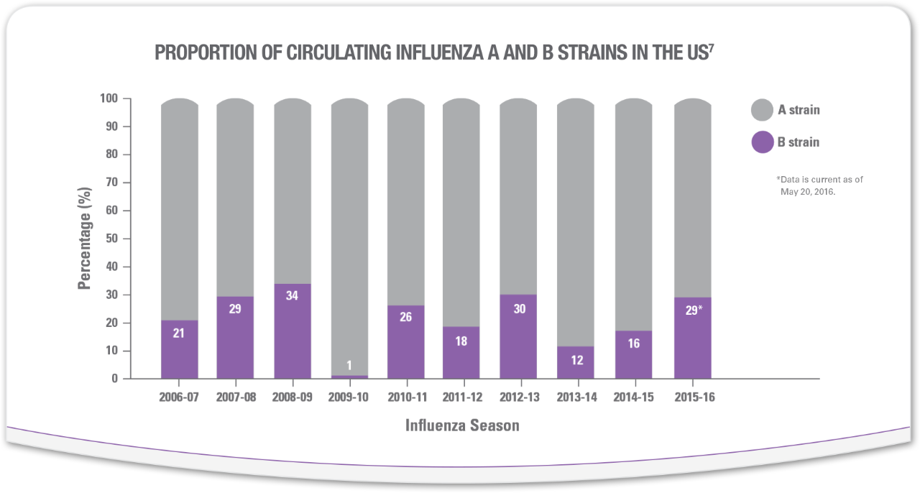
Confirmed Influenza Isolates: Type A vs Type B

Slide 33
Traditional Therapy for Influenza
therapy | possible effect
antipyretics | increased severity and duration Plaisance, Pharmacotherapy, 2000;20:1417
antitussives sedatives | decreased mucociliary action and decreasd cough (secretion retention, mucus plugging, pneumonia, atelectasis)
antihistamines decongestants | thickened secretions impaired mucus defense layer
antibiotics | impaired bacterial defense layer

Slide 34
Newer Management Options
Influenza vaccination
antiviral therapy
therapeutic
prophylactic

Slide 35
Rapid Diagnostic Tests
Four commercially available kits
Directigen™ Flu A+B *
Flu OIA® *
ZstatFlu™ *
QuickVue® (CLIA waived, October 4, 2000)
* CLIA certification required
Notes:
One of the most recent advances in diagnosis of influenza has been the development of rapid diagnostic tests, ie, kits that facilitate a move toward office-based testing for viral antigens. The differences among the four commercially available tests, as well as the Roche Influenza A/B Rapid Test will be explored in the following slides.
It is important to note that as of October 4, 2000, only one of these kits (QuickVue®) has received "waived" status under the Clinical Laboratory Improvement Amendments (CLIA).¹⁹ These federal guidelines, administered by the Health Care Financing Administration (HCFA), provide minimum quality standards for lab tests performed on specimens taken from humans—whether the tests are conducted in independent facilities, hospital laboratories or physician offices.²⁰ These standards are not simply guidelines affecting reimbursement: they are federal law.
CLIA assigns tests to three categories: waived, moderate complexity or high complexity.²¹ Because most rapid diagnostic flu tests are not CLIA waived, any office practice performing these tests must adhere to more stringent CLIA guidelines than those governing waived tests. These guidelines include standards for proficiency testing, patient test management, quality control, personnel qualifications and quality assurance.
Slide 18
Lecture Notes

Slide 36
The Value of Surveillance
Monto, Arch Int Med 2000;160:3243
3744 patients in 231 centers
influenza known to be circulating
cough and fever (>100.0ºF) alone had an 80% positive predictive value for influenza (p<.001)
“…when influenza virus is confirmed in a region, persons with fever, muscle aches, and cough most likely have influenza.”
Treanor JJ. In: Mandell, Douglas, and Bennett’s Principles and Practice of Infectious Diseases. 5th ed. 2000:1837.
Notes:
One of the key diagnostic features of influenza is the prevailing epidemiology. That is, the constellation of classic signs and symptoms in the setting of a local or regional outbreak of virologically confirmed influenza is an extremely accurate indicator of infection in a particular individual.⁴ The accuracy of a clinical diagnosis in a community outbreak of influenza has been estimated to be as high as 85%.⁴
Slide 12
Lecture Notes

Slide 37
Influenza Activity in the US 2010-2016

Slide 38
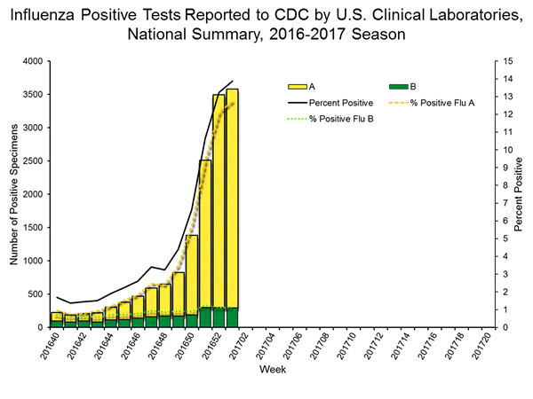
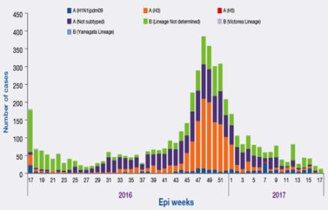

Slide 39
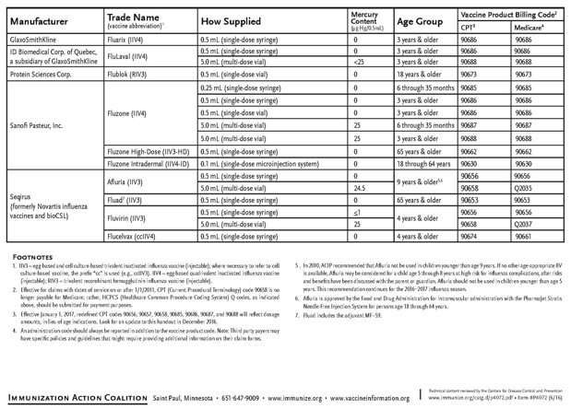
2017-18 Influenza Vaccine
2 March 2017
an A/Michigan/45/2015 (H1N1)pdm09-like virus;
an A/Hong Kong/4801/2014 (H3N2)-like virus; and
a B/Brisbane/60/2008-like virus.
166-173 million doses available

Slide 40
Efficacy of the 2015-16 Influenza Vaccine
Statistically, 43% effective in completely preventing illness 2016-17; significantly reduces severity in >80%
Composite of past 10 years
70%-90% effective in preventing illness <65 yrs old
30%-70% in preventing hospitalization in elderly not in chronic care facility
30%-40% in preventing illness in frail elderly
50%-60% in preventing hospitalization in nursing home elderly
80% in preventing death in nursing home elderly
Notes:
According to the Advisory Committee on Immunization Practices, when an influenza vaccine accurately reflects the strains of circulating viruses, clinical efficacy in preventing infection or its complications can be quite high. For example, it can be expected to be³:
Most effective (70%-90%) in preventing illness in persons under the age of 65 years (an often overlooked point since so many recommendations regarding influenza tend to focus on the elderly and the high-risk patient)
30%-70% effective in preventing hospitalization due to pneumonia and influenza in elderly patients who are not residents of a chronic care facility
30%-40% effective in preventing influenza illness in the frail elderly
50%-60% effective in preventing hospitalization due to pneumonia and influenza in elderly residents of nursing homes
80% effective in preventing death in elderly nursing home residents
Slide 36
Lecture Notes

Slide 41
Tamiflu

Slide 42
Viral Titers in Nasal Lavages
Drug Administration
Placebo (n=13)
Median log₁₀ Tissue Culture-Infective Dose per mL
P =0.02.
oseltamivir phosphate (n=56)
Inoculation
Time (h)
Hayden JAMA 1999;282:1243.
Notes:
The efficacy analysis was based on 69 (56 Tamiflu™ [oseltamivir phosphate], 3 placebo) of the 80 subjects who had laboratory-documented infection. Peak viral titers were observed about 1 days after challenge (12 hours after starting study drug) in both groups and tended to be lower in the Tamiflu recipients. At 24 and 36 hours after initiation of study drugs, the median viral titers were reduced by 2.1 log₁₀ and 3.5 log₁₀, respectively, in the combined Tamiflu group compared with placebo (P=0.02 by AUC analysis). No significant differences were observed across the Tamiflu dose groups, although the 200-mg-once-daily group had a higher viral titer AUC value compared with the twice-daily-dose groups.¹
Slide 12
Lecture Notes

Slide 43
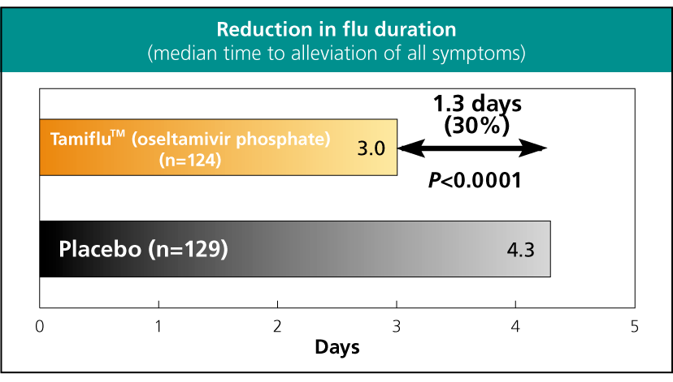
Naturally Occurring Influenza – Results – Outcome
Treanor JAMA 2000;283:1016
Notes:
Slide 19
In both studies at the recommended dose of Tamiflu™ (oseltamivir phosphate) 75 mg twice daily for 5 days, there was a 1.3-day (30%) difference in the median time to improvement in subjects receiving Tamiflu compared with subjects receiving placebo twice daily for 5 days.^{2,3}
Lecture Notes

Slide 44
Oseltamivir phosphate Significantly Shortened Duration of Symptoms
Adapted from Whitley RJ, et al. Pediatr Infect Dis J. 2001;20:127-133.
Notes:
Oseltamivir phosphate significantly reduced the median time to overall alleviation of symptoms by 36% (4.2 days vs 2.6 days) (P<0.0001) on the validated Canadian Acute Respiratory Illness and Flu Scale (CARIFS),^{19,20} in which a constellation of 18 symptoms are individually graded on a scale of 0 to 3. Scores were taken from diary cards completed by subjects’ parents twice daily for 10 days and then once daily up to day 28.¹⁹
The 36% (1-day) reduction in duration of fever associated with oseltamivir phosphate was significantly shorter (P<0.0001) than that seen with placebo, as was the 45% (1.3-day) reduction of cough (P=0.0008). The median duration of nasal congestion was reduced by 34% (1 day), P=0.09. The evaluation of fever used here was not taken from the CARIFS score, but was based on time elapsed until temperature was no higher than 98.9ºF.
Slide 23
Lecture Notes

Slide 45
Oseltamivir Postexposure Prophylaxis Studies
Hayden New Engl J Med 1999;341:1336
74% reduced rate of illness
87% in higher incidence group
withdrawls (for side effects) higher in placebo group
Welliver 40th ICAAC; 9/2000; Poster #980
92% decrease in lab-confirmed influenza
Notes:
In the postexposure prophylaxis study in household contacts of an influenza-infected index case, a 92% difference in the incidence of laboratory-confirmed clinical influenza from 12% (24/200) in the placebo group to 1% (2/205) in the Tamiflu™ (oseltamivir phosphate) 75 mg- once-daily group was demonstrated. Index cases did not receive Tamiflu in the study.
Oseltamivir was generally well-tolerated. Adverse events were qualitatively very similar to those seen in the treatment studies.
Slide 5
Lecture Notes

Slide 46
Limitations
Must be given within 48 hours of symptom onset
Only works for influenza
Expense
No direct comparison with amantidine
Advantages are theoretical
Nausea

Slide 47
Pandemic, The Movie
Sudden onset of severe cough, shortness of breath, headache, bleeding from nose and lungs, turning blue and followed by death in 4-6 hours
No treatment works
Spreads rapidly, without physical contact
~50% transmission rate
Affects people 18-30 preferentially and kills ~8% of this age group in the world
100 million people in two episodes of two months each
In 24 weeks more people dead of acute illness than died in 100 years of Bubonic Plague
This was the actual scenario in 1918

Slide 48
Fall, 1918
Relatives won’t come to the aid of orphaned children
Churches disband
Women ignore government pleas for nurses
Called the Spanish Flu because Spain is one of the few countries to not censor influenza news
US Army refuses to curtail recruiting or reduce crowding, disregarding its own medical corps
The 28th President
German Army is forced to cancel its major offensive to win the War
and loses it

Slide 49
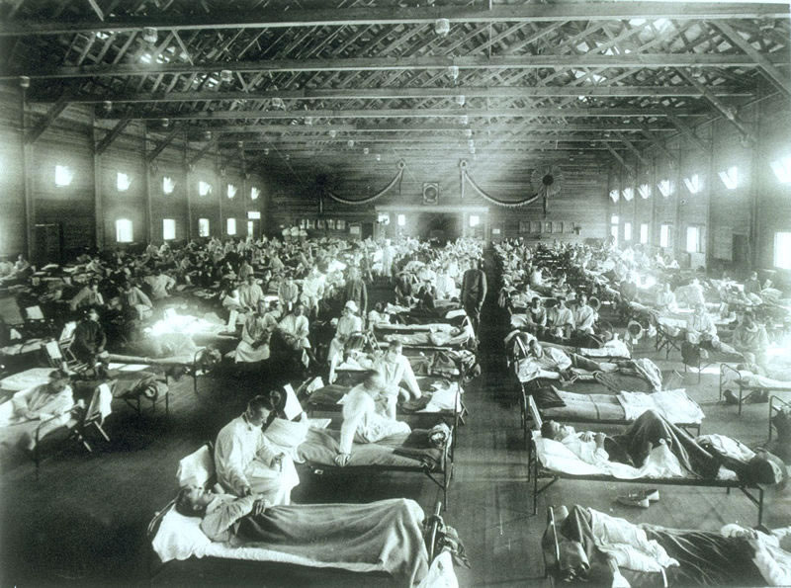
Camp Funston, Kansas 10/12/1918

Slide 50
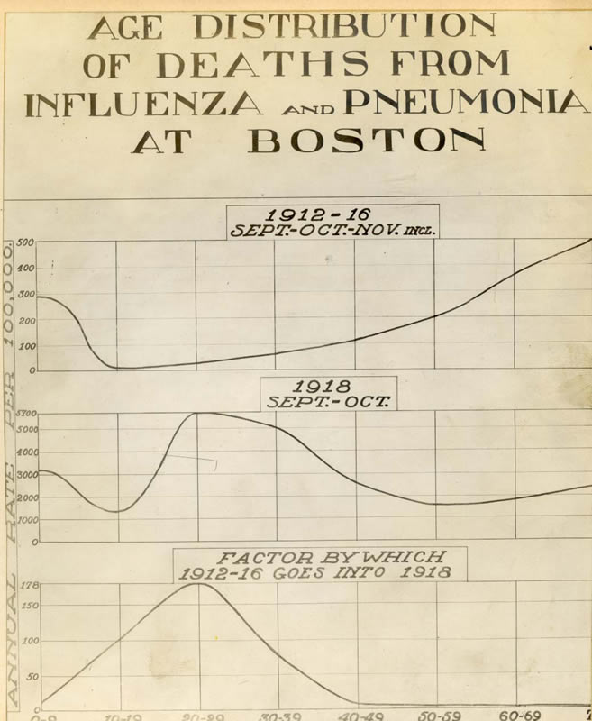

Slide 51
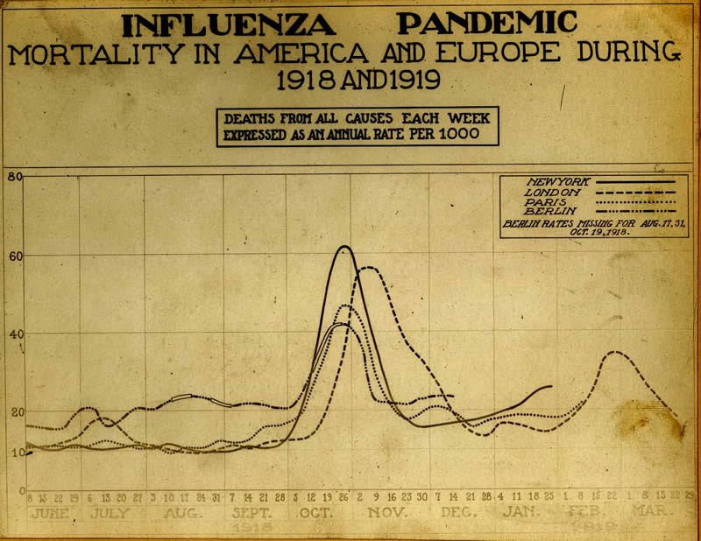

Slide 52
Influenza 1850 – 2000 Documentable Deaths

Slide 53
Influenza 1850 – 2000

Slide 54
Disasters
Event | # dead | % population
Smallpox/Measles (Mexico 1500s) | 27+ million? | >50% of natives (90%??)
Black Plague (Europe 1347-54) | 25 million | 25% of Europeans (8% of all humans)
World War II (1938-45) | 47 million (3/4 civilian) | 2.4 (1.8% of all humans)
Influenza (worldwide, 1918-19) | 21 million | 1.2 8% of young adults
Flood (Huang He River, China, 1931) | 3.7 million | 1

Slide 55
What Happened in 1918?

Slide 56
The Severity of Communicable Diseases is Based on the Susceptible Population Density
Ebola before 2014
SARS
Severe influenza
Camp Funston, Kansas, February 1917
susceptible population density
epidemic plague
Ebola after 2014
Fall normal
mild influenza
“common cold”
summer normal
disease severity

Slide 57
Ways to Reduce Susceptible Population Density
Death
debility
Immunity
Immunization
Cultural factors
Migration
Flight from cities

Slide 58
Epidemic Considerations
Peak determined partly by ability of communicable individuals to be in contact with others (“wellness”)
Leveling as density decreases (immunity, death, flight)
Infectious agent self-attenuates
Exponential increase while density remains above threshold
Susceptible individuals

Slide 59
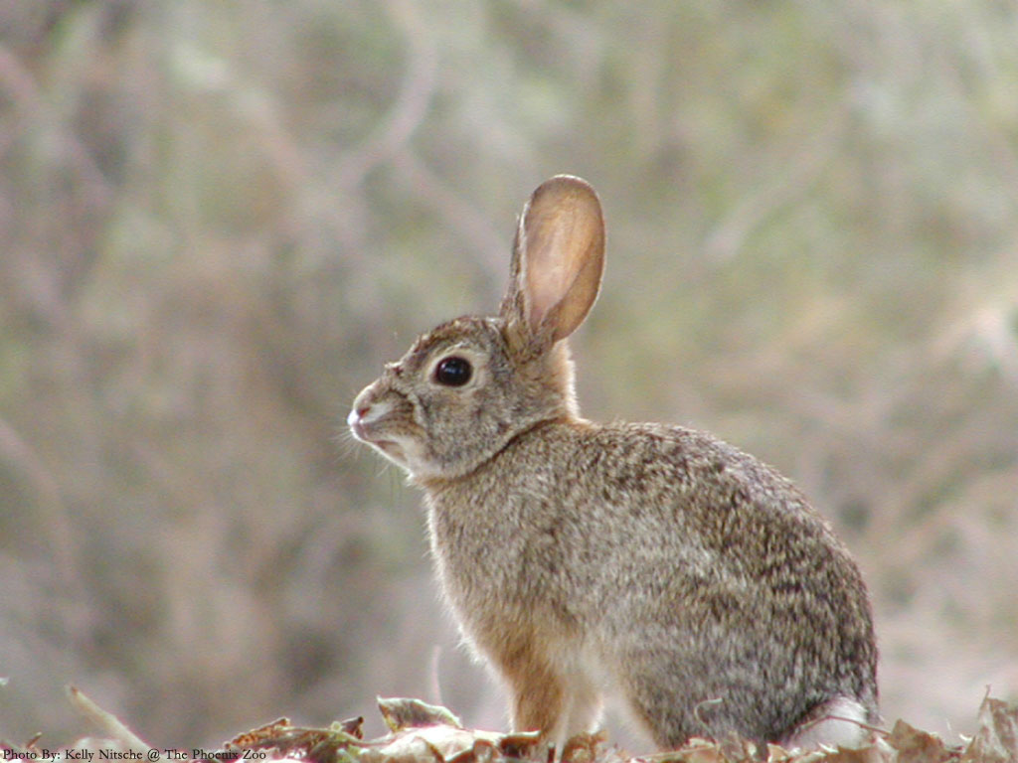
The New Zealand Rabbit Plague
Hunters
Rabbit control boards
Ferrets, weasels, stoats, and cats
Myxomatosis (1950)
Rabbit calcivirus (1997)

Slide 60
The Natural History of Disease Severity the higher the mortality rate, the more rapid the change
Survival
(months)
Time since introduction

Slide 61
So should I get a flu shot?
Side effects
The response may cause flu-like symptoms
(It’s dead so it can’t give you the flu)
Guillian-Barre (GBS) was apparently a result of poorly prepared lots in 1976 and has been about one in a million doses since then. Influenza is more likely to cause GBS than the vaccination
Allergies to components can occur
Reasons to get it
It is likely to prevent the flu in epidemic years
It might save your life
It might save the world

Slide 62
Wake Up!

