Slide 1
AVAPS – AE
Auto titration mode of non-invasive ventilation
Jack Mullany
Philips HealthTech
October 22, 2018

Slide 2

Happy Respiratory Care Week!

Slide 3
Objectives
At the end of this presentation the attendee will be able to:
Describe the three main components of the AVAPS-AE mode on the Trilogy
Identify three types of PAP therapy used for patients with OSA
Discuss the difference between AVAPS on the V60 vs. AVAPS on the Trilogy
Notes:
These are the terms most commonly used to describe the frequency of sleep apnea. The Apnea Index is defined as the number of apneas per hour of sleep. The Apnea/Hypopnea Index, or AHI, represents the total number of apneas and hypopneas per hour of sleep. This has also been called the Respiratory Disturbance Index or RDI.
An AHI < 5 is considered normal. What frequency above this level requires therapy or leads to adverse clinical consequences is controversial. The sleep apnea syndrome, or clinical sleep apnea, is defined as recurrent apneas or hypopneas that are associated with clinical impairment, such as daytime sleepiness, motor vehicle accidents or cardiovascular disease.
.

Slide 4
AVAPS-AE
Average Volume Assured Pressure Support – AutoTitrating EPAP
AVAPS-AE is a auto-titration mode of noninvasive ventilation designed to better treat respiratory insufficiency patients (OHS, COPD and NMD) in the hospital and homecare environments
Proven performance of AVAPS
– Maintains targeted tidal volume COPD / OHS
Auto EPAP
– Maintains patent upper airway at comfortable pressure OSA
Auto backup rate
– Applies an auto backup rate near a patient’s resting rate COPD
Notes:
I would like to introduce you to a new mode of NIV designed to treat all of your respiratory insufficiency patients in either the hospital or the home environments.
The three main components to AVAPS-AE are:
AVAPS, Average Volume Assured Pressure Support – A proven NIV algorithm that allows you to volume ventilate a patient noninvasively using a pressure support device.
Auto EPAP – Airway obstruction is an important factor when considering to noninvasively ventilate a patient. Philips Respironics has been treating patients diagnosed with airway obstructions with these algorithms for more than 20 years and now we are bringing it to you in a NIV device.
Auto backup rate – The auto backup rate allows the BiPAP A40 to determine the appropriate rate for the patient. The resulting rate is similar to what clinicians have been doing for years to determine an appropriate back-up rate for a patient.

Slide 5

COPD and hospital readmissions
The Centers for Medicare and Medicaid Services (CMS) has begun financially penalizing hospitals if their 30-day readmission rates are higher than expected
In 2015, readmission for COPD was added to those diagnoses already on the list: heart attack (19%), heart failure (27%), and pneumonia (20%)¹
Respiratory therapists must play an active role in reducing acute exacerbation of COPD and readmissions to reduce the number of ‘frequent flyers’
¹Medicare Hospital Readmissions: Issues, Policy Options and PPACA. September 2010.
Notes:
Philips RDD can partner with RTs to better manage COPD patients from the hospital to home and help to reduce readmissions.

Slide 6
COPD in the US today
What do these numbers mean to you?
1 million
23%
$49 billion
Number of COPD patients admitted to US hospitals in 2012 for acute exacerbation¹
Hospital readmissions for COPD within 30 days; many of these readmissions may be preventable²
Estimated cost of these readmissions to the US healthcare system; hospitalizations are among the most expensive form of healthcare; inpatient stays increase the risk of acquiring healthcare-associated infections³
¹Perera et al. Acute exacerbations of COPD in the United States, inpatient and predictors of cost and mortality. COPD 2012;9:131-144.
²Jencks et al. Rehospitalizations among patients in the Medicare fee-for-service program. N Engl J Med. 2009;360:1418-28.
³PRHI Readmission Reduction Guide. A Manual for Preventing Hospitalizations. January 2011:4.

Slide 7
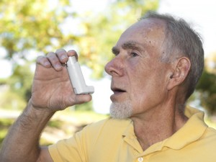
Re-admission factors
45%
Lacked Medication Knowledge
69%
Medication Non-compliance
37%
No follow-up with physician
31%
Infection post discharge
51%
Lacked Device Knowledge
42%
Unable to self care
Source: AARC webcast August 28, 2012 “Hospital to Home-efforts at Reducing Hospital Readmissions”. Greg Spratt BS, RRT; Kimberly Wiles BS, RRT; Becky Anderson RRT.
Notes:
69% were non compliant with meds
51% lacked knowledge: How to use Therapy Devices
42% unable to self manage care
31% develop infection post discharge
37% had no follow up visit with Physician
45% inadequate knowledge of medications

Slide 8

AVAPS-AE: Why do we need it?
Notes:
Goal: Provide consistent tidal volume delivery resulting in a patent airway along with a comfortable and automated backup rate.
Pressure Support ventilation alone cannot provide consistent tidal volumes
– AVAPS continuously titrates PS to maintain targeted tidal volume
EPAP requirements to maintain airway patency can change
– AVAPS AE continuously titrates EPAP and automatically adjusts to maintain airway patency
Auto backup rate
– Designed to provide a auto backup rate based on patient’s spontaneous respiratory rate to support comfortable sleep
Pressure support ventilation is accepted by patients and can be adjusted for patient comfort. AVAPS-AE allows the patient to breath spontaneously whenever they want and is very forgiving of leaks due to the available triggering technologies (Auto-Trak, Sensitive Auto-Trak and Flow Triggering). The achilles’ heel of Pressure Support is that it does not provide a consistent level of ventilation…the pressure is consistent, but the volume is not. AVAPS-AE can fill this potential therapy gap by adjusting the Pressure Support level to keep the targeted tidal volume in sight.
Auto EPAP solves an unfulfilled need for NIV therapy. Patients who need NIV are no different than patients who have OSA. They all have the potential for varying degrees of airway obstruction. You could titrate their EPAP to a level that corrects all of their OSA events, but that could be a very high level that they don’t need all the time. If you add the higher levels of PS that a ventilation patient needs, the total could be a very high pressure that is uncomfortable to a patient. An Auto EPAP solution can allow the same level of airway patency at lower mean EPAP pressures that can translate into more comfort for the patient.
Auto backup rate is a very simple solution to providing a backup rate for your patient. It essentially counts the spontaneous rates just like you would and sets the rate based on the patient’s rate. It also provides for some flexibility around that rate if the patient is breathing spontaneously, which should be more comfortable for the patient.

Slide 9
Prevalence of OSA in the United States
5% of population is estimated to have undiagnosed OSA¹
As common as adult asthma¹
Obstructive Sleep Apnea/Hypopnea (OSA/H) prevalence:
  Wisconsin study^{2,3}:
    24% of men, 9% of women: Apnea/Hypopnea Index (AHI) > 5
    9% of men, 4% of women: AHI>15
    4% of middle-aged men, 2% of middle-aged women: AHI > 5 and daytime sleepiness
  Pennsylvania study⁴:
      17% of men AHI >5
      7% of men, 2% of women: AHI >15
¹ Young, et al., AJRCCM 2002
² Young, et al., NEJM 1993
³ Redline, et al., AJRCCM 1997
⁴ Bixler, et al., AJRCCM 1998 & 2001
Notes:
It is estimated that 52 million people in the U.S. have an apnea/hypopnea index > 5. Sleep apnea is as common as adult asthma. It affects all races, ages, and socio-economic groups.
Young, et al., AJRCCM 2002 - In 2002, a comprehensive review of the epidemiological studies was released in the American Journal of Respiratory and Critical Care Medicine (Young, Peppard and Gottlieb, AJJRCM 2002:165:1217-1239).
Young, et al., NEJM 1993 - A study in the New England Journal of Medicine (Young, et al., April 1993) reported that in a group of 602 employed men and women, aged 30 to 60, 24% of the men and 9% of the women had an apnea index of >5. This same study stated that 4% of the men and 2% of the women had OSA (using the minimal diagnostic criteria of 5 or more apneas or hypopneas per hour of sleep and excessive daytime sleepiness). This is known as the Wisconsin Study.
Bixler, et al., AJRCCM 1998 & 2001 - 1741 people with 17% of men with an AHI >5 and 7% of men and 2% of women with an AHI >15. (Page 3 of Young, Peppard and Gottlieb, AJRCCM 2002:165:1217–1239).
The majority of people with OSA remain undiagnosed and untreated.

Slide 10
STOP-BANG Questionnaire
S Snoring: Do you snore loudly (louder than talking)?
T Tired: Do you often feel tired, fatigued or sleepy during the daytime?
O Observed: Has anyone observed you stop breathing during sleep?
P Blood pressure: Do you have/are you being treated for high BP?
B BMI: BMI more than 35 kg/m2
A Age: Age over 50 years
N Neck circumference: Neck circumference greater than 40 cm
G Gender: Male
Anesthesiology.2008;108:812-21.

Slide 11
Measures of sleep apnea frequency
Apnea Index
  # apneas per hour of sleep
  # of obstructive apneas per hour of sleep
  # of central apnea’s per hour of sleep
Hypopnea Index
  # of reduction in patient flow per hour of sleep
  # of central or obstructive hypopnea’s per hour of sleep
Notes:
These are the terms most commonly used to describe the frequency of sleep apnea. The Apnea Index is defined as the number of apneas per hour of sleep. The Apnea/Hypopnea Index, or AHI, represents the total number of apneas and hypopneas per hour of sleep. This has also been called the Respiratory Disturbance Index or RDI.
An AHI < 5 is considered normal. What frequency above this level requires therapy or leads to adverse clinical consequences is controversial. The sleep apnea syndrome, or clinical sleep apnea, is defined as recurrent apneas or hypopneas that are associated with clinical impairment, such as daytime sleepiness, motor vehicle accidents or cardiovascular disease.
.

Slide 12
Measures of sleep apnea frequency
Apnea / Hypopnea Index (AHI)
  Number of apneas + hypopneas per hour of sleep
Arousal Index (AI)
  When the patient arouses from sleep or changes sleep staging that does not normally occur at night
  Number of arousals in EEG activity per hour of sleep
  Associated with apnea/hypopnea/desaturation events
  Associated with other events (PLM, seizure, etc.)

Slide 13

Classification of respiratory events
Mild sleep apnea
  AHI is 5 to 15 with excessive daytime sleepiness (EDS)
Moderate sleep apnea
  AHI >15 to 30 with EDS
Severe sleep apnea
  AHI > 30 with EDS
Notes:
When a patient enters the sleep lab and has been identified as having sleep apnea, the goal of the PAP titration is to eliminate apneas, hypopneas, and desaturations. The sleep lab eliminates the events through proper titration of positive airway pressure therapy. Based on what is required by the sleep technician to provide the patient with appropriate therapy to maintain their airway, the patient will be discharged from the lab after a titration with a prescription for PAP therapy. In addition, the patient may also be required to change sleep hygiene, positioning during sleep, or try other methods to improve sleep at night.

Slide 14

Patients to consider for OSA screening
C/O fatigue or unrefreshed sleep
Hypertension (HTN)
  Newly identified HTN
  Resistant or refractory HTN
CHF with nocturnal angina or Cardiovascular (CV) disease
Bariatric patients
Patients with large necks
  17 in for men, 16 in for women
Patients with small jaws
Patients with metabolic syndromes
Notes:
OSA is the most prevalent of sleep-related disorders.
Types of patients or patient complaints you should consider when exploring or attempting to identify patients with sleep apnea are:
Complaints of fatigue or un-refreshing sleep
Patients with hypertension (consider in all newly diagnosed patients with HTN as well as patients with resistant/refractory hypertension)
Patients with CHF
Patients who have had or are being evaluated for Bariatric surgery
Patients with large neck sizes (17 inches for men and 16 inches for women)
Patients with small jaws (micrognathia)
Patients with metabolic syndromes (such as diabetes)

Slide 15
PAP therapy for patients with OSA
CPAP
    One level of pressure on inspiration and exhalation
    Device may have the option to provide pressure relief in early exhalation
Bi-level therapy
    One level of pressure on inspiration and lower level of pressure on expiration
    Device may have the option to provide pressure relief in early exhalation
Auto titration therapy
    Device pressure is adjusted based on airway dynamics and device algorithm
Notes:
A CPAP system pneumatically splints the upper airway open throughout the breathing cycle. It is recommended that the level of pressure be determined for each patient during a sleep study. CPAP has been the standard therapy for OSA since 1985.
C-Flex is a new technology that delivers one level of pressure with a variable expiratory relief setting. The patient chooses what they feel is the right level of pressure relief – which may increase comfort when exhaling.
Bi-level and auto-CPAP therapy may also be used to treat OSA.
Bi-level therapy utilizes two levels of pressure to splint the airway open. A lower pressure is delivered on exhalation (EPAP) and a higher pressure on inspiration (IPAP). The use of bi-level therapy is driven by reimbursement criteria. Bi-level therapy is indicated when a patient does not tolerate CPAP or does not respond to CPAP. This can be determined during the sleep study or after the patient is on therapy in the home.
Auto titration therapy automatically adjusts pressure based on the patient’s airway dynamics and the device algorithm

Slide 16

AVAPS: proven effective
Automatically titrates pressure support
  Changes in body position
  Sleep stage
  Changes in respiratory mechanics
Delivers average tidal volume
  Within the night
  Long-term progression
AVAPS produces results comparable to sleep lab titration of PS¹
  CO₂ reduction
  Health-related quality of life
  Sleep quality
¹Murphy, PBThorax thoraxjnl-2011-201081: Published Online First: 1 March 2012 doi:10.1136/thoraxjnl-2011-201081

Slide 17
AVAPS: Potential indications
Acute settings
  Post-surgical period (OSA patients)
  “Acute” OHS
Chronic settings
  Chronic respiratory disorders
  Sleep-related pathologies
  Any ventilator dependent patient with tracheotomy
  Progressive neuromusuclar disorders
Notes:
New indications for AVAPS for the acute setting could be the post-surgical period (this is when OSA can be a problem if not detected previously) and acute OHS. In chronic settings, it could be used with chronic respiratory disorders, sleep related pathologies and any ventilator dependent patients with a tracheotomy, as well as progressive neuromuscular disorders.

Slide 18
AVAPS
This mode is not a PRVC type mode
  It will not respond quickly
Not intended for patients with high resistance and low compliance
  Patients should be through their acute phase
It is ideal for stabilized chronic patients
The use of a nasal mask in AVAPS mode is not recommended
Notes:
Just a note, AVAPS is not a PRVC type of mode. It does not respond quickly to assure fast changes in tidal volume requirements. It is not intended for patients with high resistance and low compliance. Make sure to set proper expectations for AVAPS performance. As stated before, this mode is ideal for stabilized chronic patients. The use of a nasal mask in AVAPS mode is not recommended and it is very important to set an appropriate Min P. Why? Because in the event the patient exhales though their mouth instead of into the mask, the V60 is unable to accurately measure the leak and may over estimate the true tidal volume. If the estimated VT is above the target VT, the ventilator will reduce IPAP and if the Min P is set too low the patient may be under ventilated. Alternatively, when you use a full face mask and the patient breaths out through their mouth the flow is returned to the mask and it does not create the same issue. Keep in mind that a properly set Min P would prevent IPAP from decreasing in the above discussed situation.

Slide 19
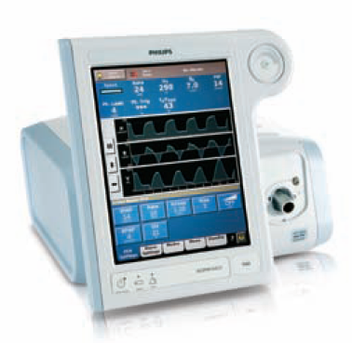
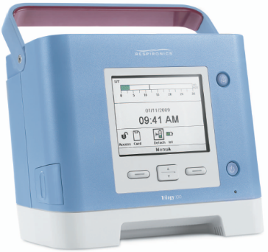
AVAPS on the V60 vs. Trilogy
Mode or Option | V60 | Trilogy
AVAPS | Mode | Option in S, S/T, PC and T Modes w/ Passive circuit
AVAPS-AE | N/A | Mode

Slide 20
AVAPS on the V60
V60: AVAPS can be used as a Mode on the V60 ventilator
  Vent automatically modifies pressure to maintain an average target user-defined VT
    1 cmH₂O to possibly 2.5 cmH₂0 per minute change in pressure
  During AVAPS setup, there may be a period of time before the target tidal volume is achieved
  AVAPS should not be used when rapid IPAP adjustments are needed to achieve the desired VT
Notes:
AVAPS is a features on the Trilogy 2O2 and is available in S, S/T, PC and T modes. AVAPS assist patients in maintaining a target Vt by automatically controlling the pressure support. If the Ramp function is activated, it will take precedence over the AVAPS feature.

Slide 21
AVAPS on the V60
AVAPS automatically adapts pressure support (< 2.5 cmH₂O) per minute to guarantee an average tidal volume
IPAP Min
EPAP
Target V_{T}
Notes:
As you can see by this representation, AVAPS automatically adapts pressure support to guarantee an average tidal volume less than 2.5 cmH₂0 per minute.

Slide 22
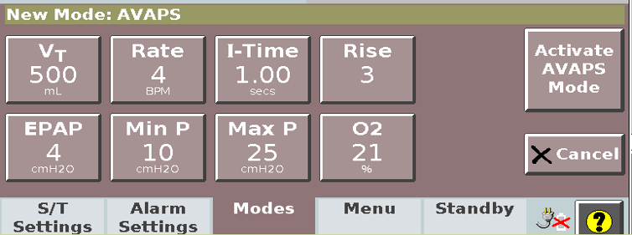
AVAPS on the V60
AVAPS-specific settings: target VT, Min P, and Max P
If calculated target pressure is outside the minimum or maximum pressure range Target VT will not be achieved
Notes:
To set up AVAPS, you set your target tidal volume, your Min P (which is the minimum IPAP pressure) and your Max P (maximum IPAP pressure). The best way to set up AVAPS is to observe the set EPAP/IPAP and tidal volume readings on S/T mode. Set your Min P at what your IPAP value was on S/T. Set your Max P above the Min P at a value that the patient will be able to achieve an increased flow/pressure when they need it. If the calculated target pressure is outside the minimum or maximum pressure range, the target tidal volume will not be achieved.

Slide 23
AVAPS option on the Trilogy
Average volume assured pressure support (AVAPS) is an option available in S, S/T, PC and T modes only
AVAPS assists patients in maintaining a target VT by automatically adjusting the pressure support
If the ramp function is activated, it will take precedence over the AVAPS feature
Notes:
AVAPS is a features on the Trilogy 2O2 and is available in S, S/T, PC and T modes. AVAPS assist patients in maintaining a target Vt by automatically controlling the pressure support. If the Ramp function is activated, it will take precedence over the AVAPS feature.

Slide 24
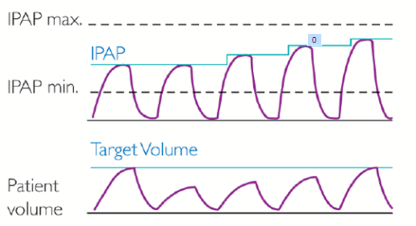
AVAPS feature
AVAPS adjusts the IPAP levels between minimum (IPAP min) and maximum (IPAP max) settings
Adjustments are made gradually over several minutes
AVAPS is available only when using a passive circuit
Notes:
AVAPS adjusts the IPAP levels between minimum (IPAP min) and maximum (IPAP max) settings. Adjustments are made gradually over several minutes. Only available when using the passive circuit.

Slide 25
Trilogy AVAPS enhancements
Flexible
  Clinicians can select AVAPS rate of change from 1.0 to 5.0 cm H₂O of pressure based on patient need
Stable Vt
  AVAPS now tracks spontaneous and timed breaths separately
  Applies correct amount of pressure support to each breath type
Accurate
  Enhanced leak estimation algorithm in Trilogy
  Better leak estimation means better Vt tracking and targeting

Slide 26
AVAPS on the Trilogy
AVAPS automatically adapts pressure support based on AVAPS rate setting (1 to 5 cmH₂O) per minute to guarantee an average tidal volume
IPAP Min
EPAP
Target V_{T}
Notes:
As you can see by this representation, AVAPS automatically adapts pressure support to guarantee an average tidal volume less than 2.5 cmH₂0 per minute.

