Slide 1
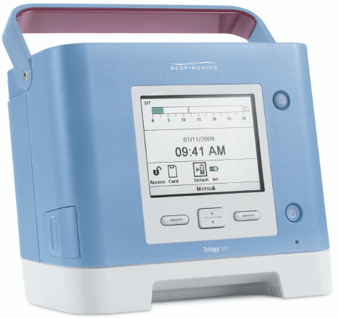
AVAPS-AE: The Mode AVAPS + Auto EPAP
Proven performance of AVAPS
Confidence that tidal volume targets are being met
Auto EPAP
Auto adjusting EPAP to meet changing patient needs
Maintains a patent airway
Auto backup rate
Maintains a breath rate designed for patient comfort (easy to use)

Slide 2
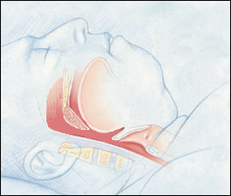
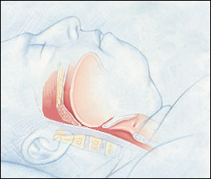
AVAPS-AE: Auto EPAP proactive analysis
Theory of Operation
Device Pressure
P search
opt
P
therapy
P search
crit
Upper Airway Resistance
Illustration courtesy of Krames Medical Illustration.
Notes:
The easy way to implement an auto device of any kind it to do the “wait then react” technique. Wait for an event to occur and then react to it by raising the pressure. That way allows events to occur first and then it tries to fix them. We think the proactive method is better and can eliminate some of those events that drive other algorithms.
This slide graphically illustrates the method used in our proactive searches for the best therapy pressure for EPAP. If you watch the picture at the left you can see initially that the airway is shown to be occluded. As pressure is gradually increased to the airway initially it remains occluded with very high airway resistance.
When enough pressure has been applied to the airway the airway opens andresistance drops sharply.
With continued increases in pressure the resistance changes become very small.
This is the area we call Popt or optimized pressure.
At this point the device will stop adding pressure to avoid unnecessary and uncomfortable pressure increases.
The device will hold pressure at this level until the next search phase.
The next search will be with gradual pressure decreases looking for the critical pressure boundary where small pressure decreases cause large changes is resistance.
This is what we call the Pcrit or critical pressure area.
The idea behind the proactive searches is to keep the pressure in a therapeutic range between the critical and optimal pressure areas, providing the lowest pressure needed for airway patency throughout the night.

Slide 3
AVAPS-AE: Auto EPAP proactive analysis
Popt – Optimal Pressure Search
(High Pressure Search)
P
opt
Pressure
P
Popt
ther
EPAP
P opt
P
P opt
P therapy
P crit
crit
P therapy
Critical Pressure Searches
(Low Pressure Search)
Resistance
P therapy
P therapy
P opt
P crit
EPAP
P crit
Pcrit
Notes:
This illustrates the proactive nature of our auto EPAP algorithm.
The device will proactively increase EPAP pressure to evaluate the impact the increase has on the airway.
This AVAPS-AE is seeking the optimum pressure or conducting a Popt search.
AVAPS-AE will do this until the pressure changes have no improvement on the airway.
At that point, AVAPS-AE will restore the pressure to the level prior to the last change and it will then search downward on the next cycle.
This is called a critical pressure search or Pcrit.
The Pcrit search will lower pressure gradually until the airway patency starts to decrease.
At that point the device will reverse the last pressure decrease and then repeat the process by conducting a Popt search next.
This method allows the algorithm to anticipate the changing EPAP pressure needs before an obstructive event occurs.

Slide 4
Auto EPAP today
Patient type | Treatment / Device | Pressure support requirements
OSA | CPAP/REMstar Auto | Low to none
Cardiac | Servo-Ventilation / BiPAP AutoSV | Dynamically applied pressure support
Respiratory insufficiency | AVAPS-AE / Trilogy, BiPAP A40 | High levels of pressure support
Notes:
So, why did we change the way we detect airway obstruction?
The difference is not how the airway responds to pressure, but rather what else we are doing with the device in regards to pressure support.
It starts with the type of patients we are treating. Patients with sleep disordered breathing can benefit from having an auto titrating CPAP or BiPAP device, but often they can be treated with a simple CPAP device.
The BiPAP AutoSV is intended for periodic breathing patients that have rapidly changing pressure support requirements.
The BiPAP AutoSV is capable of changing pressures from breath to breath by as much as 5 cm of pressure, but it typically delivers pressure support less than 10 cm of water.
Chronic hypoventilators typically need higher levels of pressure support, sometimes much higher than what is needed by a patient who is using BiPAP AutoSV.

Slide 5
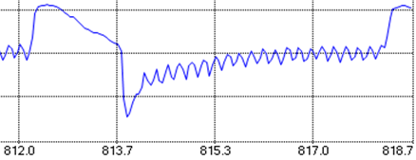
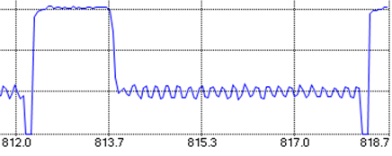
Forced Oscillation Technique - FOT
Flow
Pressure
Forced oscillation technique (FOT) at 5 Hz, 1 cm amplitude during EPAP
Notes:
For respiratory patients, our new method for an auto EPAP in AVAPS-AE is on the right. In the AVAPS-AE device, we use FOT (forced oscillation technique) to measure the airway resistance. The FOT signal is delivered at 5Hz, using a 1 cm amplitude sinusoidal signal. This resistance measurement is used instead of the flow waveform signal to determine if pressure changes result in improvements to airway patency.
Simply put, the pressure oscillations will cause flow oscillations. If the airway is obstructed, the flow oscillations will be smaller than they would be if the airway was patent. This is very similar to the pressure pulse we use to detect a “closed” or “open” airway on our CPAP devices. FOT has been used to measure resistances for many years and is in use on several other devices in the medical industry.
So, why did we change from the flow limitation method?
It goes back to patient type and the amount of pressure support that these patients need. Patients on NIV devices sometimes need very high levels of PS and this influenced our ability to detect airway obstruction based on the patient’s inspiratory flow pattern.
The PS was tending to normalize the flow pattern when it was delivered at higher levels. FOT enables accurate measurement of airway resistance in patients who need high levels of PS.

Slide 6
Benefits of FOT
FOT improves detection of obstructed airways at higher pressure support levels
Not affected by high levels of pressure support
FOT measurements taken at end exhalation (10 breaths)
R
R
R
R
Increase in EPAP by 1 cm H₂O s
Notes:
This is how the FOT is applied (supplied from DirectView software).
(Top image) The R point indicated the point in the breathing cycle where and when the resistance value is recorded.
FOT is applied before a search starts to get a baseline reading and then after the pressure increase has occurred.
The algorithm tracks the resistance from the cycle point to the trigger of the next breath.
When the next breath is triggered, the algorithm will look back ~ 100 milliseconds and use that point for R calculation as long as the breath has not been excluded from calculations.
The algorithm will also reject a breath that has a large change in leak breath to breath.
(Bottom image ) Here you can see instances where FOT is occurring.
(Bottom image ) There are ~ 14 breaths there before FOT stops.
This means that 4 of the breaths were rejected before the required 10 were obtained.
The bottom images reflect a Popt search. If you look closely you will see the initial baseline FOT measurement.
Then over 5 breaths the pressure increases 1 cm.
Then there is another FOT period where the resistance is again measured and then
compared to the previous resistance value.
The algorithm will then test the airway to see if resistance changed or stayed the same.
FOT improves detection of obstructed airways at higher pressure support levels not affected by high levels of pressure support; rejects variable leak breath to breath (>15%); FOT measurements taken at end exhalation (10 breaths).

Slide 7
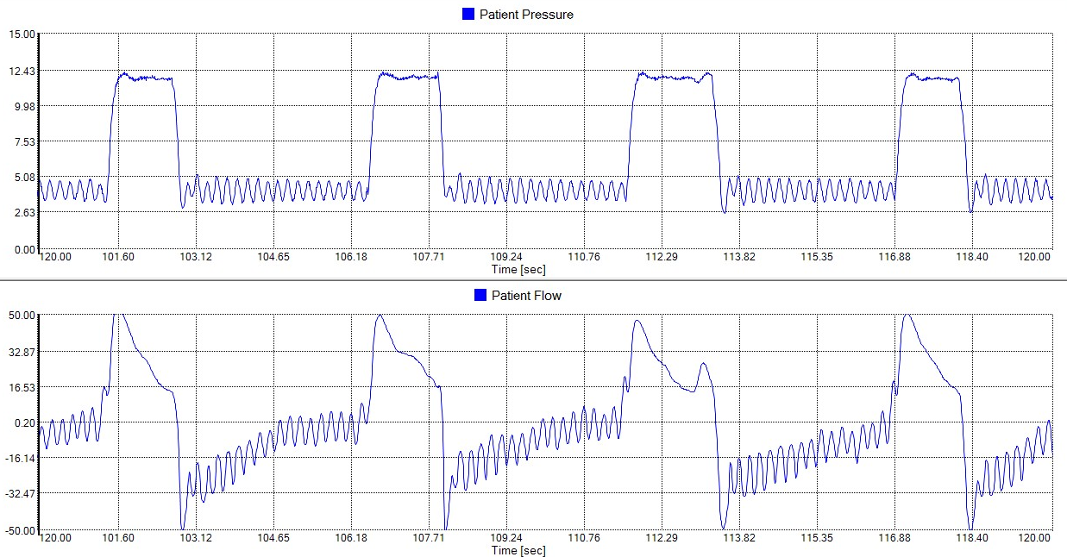
FOT – Flow resulting from pressure
FOT signal
Resulting flow

Slide 8
FOT – Patent vs. obstructed airway
Patent/Normal airway
Resulting flow (low resistance)
Obstructed airway
Resulting flow (higher resistance)
Notes:
Images compare the amplitude of the flow signals that result from the pressure oscillations in normal or patent airway vs. an obstructed airway.

Slide 9
AVAPS-AE Maintaining tidal volume and airway patency
PS max
EPAP max
PS min
IPAP
EPAP min
EPAP
Target Vt
Resistance
Notes:
What does AVAPS do for the clinician?
It is like sending a skilled therapist into the patient’s room with orders to titrate the pressure support for a specific tidal volume.
At some point, the therapist will have to leave the room. When they do, you can’t be sure what tidal volumes are going to be delivered.
But in this case the therapist never takes their hand off of the pressure support knob.
They never leave!

Slide 10
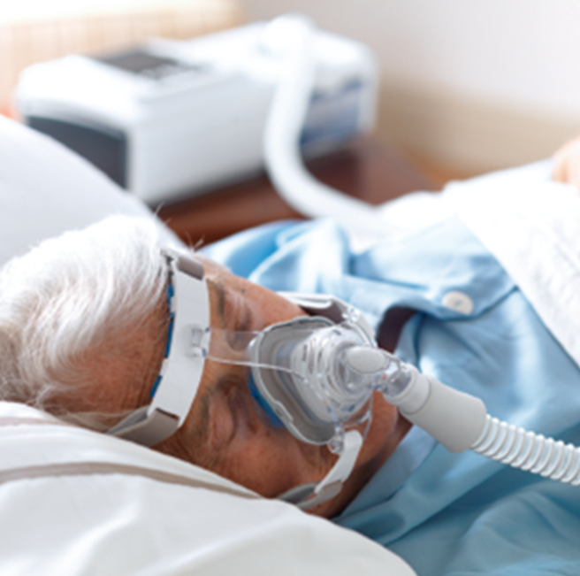
Auto Back-up rate
Auto backup rate
• Auto backup rate is near resting rate
• Comfortable assistance when needed
• No manual adjustments (auto-default
setting)
Auto backup rate combined with the tidal volume assurance of AVAPS provides a minimum level of ventilation
Notes:
• Auto backup rate is near resting rate
> Near spontaneous rate
> Minus 2 resting rate
• Comfortable assistance when needed
• No manual adjustments required (auto-default setting)
• Can define a rate if a specific rate is desired or it can be set so that there is no backup rate
which is the same as spontaneous rate

Slide 11
Auto backup rate
Targeted auto backup rate is 2 bpm below avg. spontaneous rate
Bpm
Calculated spontaneous rate
Target auto backup rate
Moving breath rate
10
Minimum auto
backup rate
Spontaneous breaths
Time 50 breaths
Notes:
The auto backup rate for AVAPS-AE will average the breath times over a 50 spontaneous breath rolling window (Array) over the 1st hour and use the highest 50 average value of spontaneous breaths to calculate the patient’s spontaneous rate.
The algorithm will continue to monitor the spontaneous breath times after the first 50 breaths and if the spontaneous rate increases during the 1st hour of use each night, then the rate will be updated to the higher rate.
Lower spontaneous rates will not update the rate.
Once a spontaneous rate has been determined, the unit will update the backup rate to 2 bpm less than the spontaneous rate.
The lowest auto backup rate is approximately 10 and the highest is 20, however the patient can breath more than 20 breaths per minute.
If a higher rate than 20 or rate less than 10 is required, then the clinician can turn off the auto function and set a desired rate or turn off any machine-delivered rate.

Slide 12
Auto backup rate
The buffer is reduced or eliminated by timed triggers.
The patient will be guided back to the targeted backup rate
The auto backup rate is buffered by spontaneous triggers to promote synchrony with the device
Bpm
Target auto backup rate
Moving breath rate
10
Auto backup rate
buffer zone
Timed Breaths
Spontaneous Breaths
Time (Night time session)
Notes:
Once the auto backup rate has been determined by AVAPS-AE with 50 spontaneous breaths it will then maintain the patient near this rate for the remainder of the night (the patient can always go higher than this rate).
So, as seen here in the first few breaths, the rate is delivering the auto backup rate because the patient is not triggering breaths. If the patient starts to trigger breaths above the auto backup rate, the algorithm will promote synchrony with the vent by allowing some flexibility with the rate.
As the patient continues to trigger more spontaneous breaths, the rate may be suppressed by as much as 25% of the spontaneous rate. If the spontaneous rate is 18 bpm, that would set the target rate at about 16 bpm. The lower limit of the comfort buffer zone will now be 25% below the rate of 18 bpm. So the lower limit of the comfort zone is ~ 13.5 bpm. 16 bpm is an interval of about 3.8 seconds between triggers. 13.5 bpm is about 4.4 seconds between triggers. This means that if the patient has been breathing spontaneously and has developed the full amount of buffer they will be allowed to take a spontaneous breath as long as 4.4 seconds apart. If the patient fails to trigger after 4.4 seconds they will get a timed breath from the device and the amount of comfort zone buffer will be reduced. If the patient continues without triggers the rate will slowly bring them back to the target within one minute.
Remember….Spontaneous triggers add to the buffer zone (up to the max of 25% below the spont rate) and timed triggers will reduce it.

Slide 13
Auto backup rate: Patient comfort features
Comfort feature intent: Minimizes patient/device asynchrony
– Rate will not exceed patient’s initial resting
spontaneous rate
– Machine breath delayed if patient is still exhaling
– AVAPS-AE allows patient to terminate a machine
delivered breath, helping to reduce gas trapping in
patients with COPD
Confidential

Slide 14
AVAPS-AE suggested settings
VT target | 8 -10 ml/Kg IBW | 8 ml/Kg IBW
MaxP | 35 cmH2O | 30 cmH2O
PSMax | 19-35 cmH2O | 30 cmH2O
PSMin | 14-19 cmH2O | 12 cmH2O
EPAP Max | 14 cmH2O | 14 cmH2O
EPAP Min | 4 cmH2O | 4 cmH2O
Breath Rate | Auto | Auto
AVAPS Rate | 2 cm/min | N/A
 | OHS | COPD - OSA
AVAPS-AE protocol Dr. N. Hart, Dr. P. Murphy, Lane Fox Respiratory unit, St. Thomas’ Hospital London UK *
AVAPS-AE Multi Center Trial protocol l,ProfJean François MUIR, France

Slide 15
Multifaceted COPD program shown to improve care
1. Coughlin S., Liang WE, Parthasarathy S. Retrospective Assessment of Home Ventilation to Reduce Rehospitalization in Chronic Obstructive Pulmonary Disease. J Clin Sleep Med. 2015 Jun 15;11(6):663-70.
Notes:
Philips, in partnership with Barnes Healthcare, recently conducted a clinical study that examined the interactions between technology, the care team, and readmissions.

Slide 16
Talking Points: Patient Touch Details
Reducing Hospital Readmissions in COPD Patients
Patient Education at home:
1st week after discharge: 2 home visits*and 1 phone call by RT
Next 90 days: Monthly Visits
Ongoing care: Visits every 3 months
First 30 days after discharge: Additional 6 home visits
Telestation Monitoring
*Visits were 30-45 minutes in duration
Notes:
Patient education and monitoring is pivotal to the success of Barnes Program. As you can see there are ongoing visits to the patient in the first, week, month and in 3 month intervals on an ongoing basis. Telestation home monitoring was part of the each patient’s care plan for the first 30 days

Slide 17
Proven to reduce readmissions
In a review of 398 COPD patients*
88% reduction
in hospital readmissions¹
*All receiving NIV and meeting program eligibility requirements. All subjects were admitted at least twice in the prior 12 months before enrollment.
1. Coughlin S., Liang WE, Parthasarathy S. RetrospectiveAssessment of Home Ventilation to Reduce Rehospitalization in Chronic Obstructive Pulmonary Disease. J Clin Sleep Med. 2015 Jun 15;11(6):663-70.
Notes:
And while we're talking results, let's look at the hard data that this study produced. if there was just one slide I could show you, it would be this. One COPD resulted in an 88% reduction in hospital readmission. It is the only clinical protocol out there backed by this sort of proof.

Slide 18
Effective COPD Management Plans
Overall Goals
Ultimate Goals
Stable COPD Patient
Overall Goals
Inhibit disease progression
Alleviate symptoms
Increase exercise tolerance
Improve health status
Ultimate Goals
Prevent and treat exacerbations
Prevent and treat complications
Moderate mortality
Notes:
So, lets stop for a minute and look at some of the things we have been discussing today.
As we know, an effective COPD management plan includes the ability for the HCP to (1) assess and monitor disease; (2) reduce risk factors; and (3) manage stable COPD
So the overall goals for the patient to become stable should include:
Inhibit disease progression
Alleviate symptoms
Increase exercise tolerance
Improve health status
And thus the ultimate goals for the patient to remain stable will be to :
Prevent and treat exacerbations
Prevent and treat complications
Moderate mortality

Slide 19
Perceptions of home ventilation
Past
Invasive 24/7 support
Complex devices
High risk
High patient Interaction
Present
Invasive – Traditional
Noninvasive – Newer, simpler applications
Easy to use
Invasive or NIV
Portable
Many options for interfaces
Multiple noninvasive modes and features
Patient use ranges from nocturnal to full support

Slide 20
Diseases that benefit from NIV
Chronic Obstructive Pulmonary Disease (COPD)
consequent to chronic respiratory failure
Obesity Hypoventilation Syndrome (OHS)
Muscular Dystrophies
ALS
Higher Spinal Cord Injuries
Other myopathies: Acid maltase deficiency, polymyositis, mitochondrial disorders
Neurological disorders: Spinal muscular atrophies (SMA l,ll,lll)
Neuropathies: Guillain-Barre syndrome, Multiple Sclerosis
Skeletal pathologies such as kyphoscoliosis

Slide 21
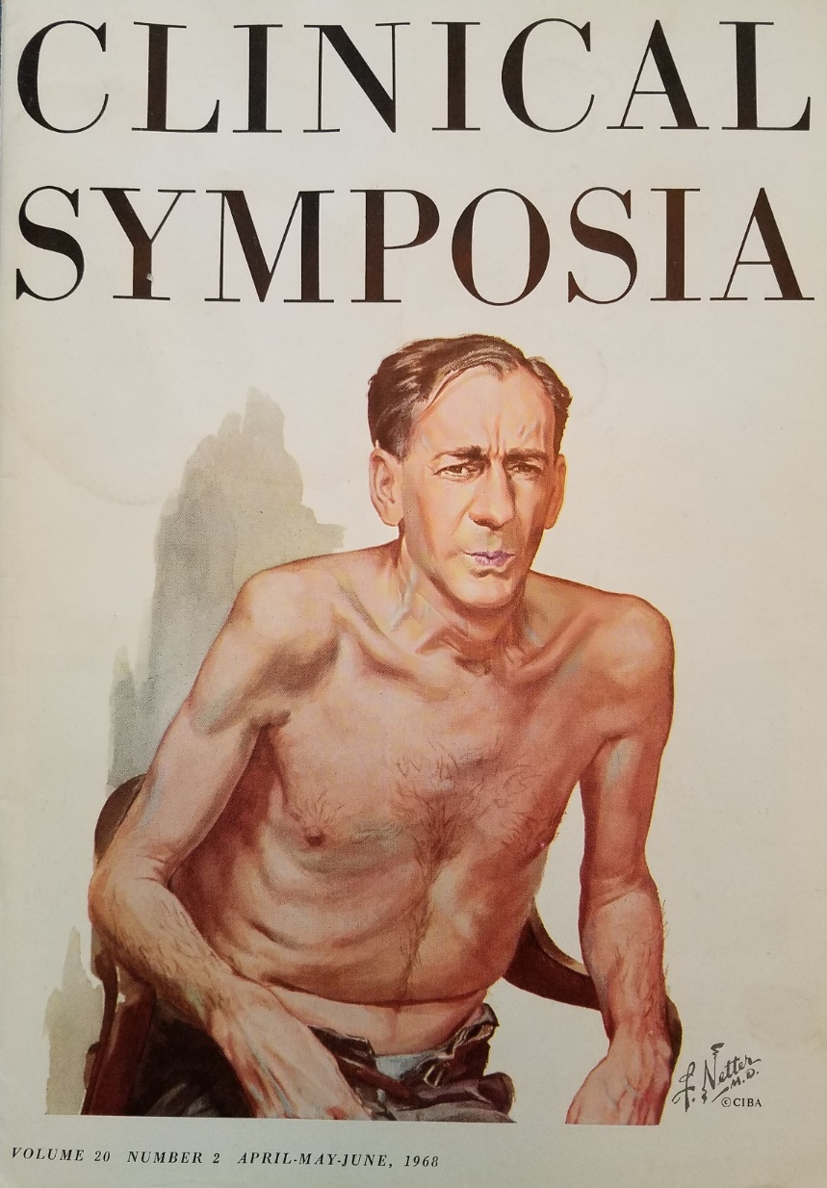
Identifying the right patient for NIV
COPD patients that are late stage 3 or stage 4
Multiple COPD readmissions in the last year
Increasing pharmacological treatment with little reward
Patients that have tried/failed PAP and/or their current device is not effective anymore
Patients that have limited activity due to shortness of breath

Slide 22
Medicare Ventilator National Coverage Determination (NCD)
Vents are covered for in-home use for:
“Neuromuscular diseases, thoracic restrictive diseases, and chronic respiratory failure consequent to chronic obstructive pulmonary disease.”

Slide 23
Vent Coverage Criteria Changes
RAD LCD (Re) “Clarification”
Each of these disease categories are comprised of conditions that can vary from severe and life-threatening to less serious forms.
Choice of an appropriate device i.e., a ventilator versus a bi-level PAP device is made based upon the severity of the condition.
CMS distinguished the use of respiratory product types saying that RAD is “distinguished from ventilation in a patient for whom interruption or failure of respiratory support leads to death.”
In most regions, strictly enforced 24/7 usage (with breaks of 2 minutes – 2 hours)
THEN
“Choice of an appropriate treatment plan, including the determination to use a ventilator vs. a bi-level PAP device, is made based upon the specifics of each individual beneficiary’s medical condition. In the event of a claim review, there must be sufficient detailed information in the medical record to justify the treatment selected.”
No reference to the need for the ventilator where interruption of use would quickly lead to serious harm or death.
No reference to the duration of use of the vent needing to be “continuous’ or 24/7.
NOW

Slide 24
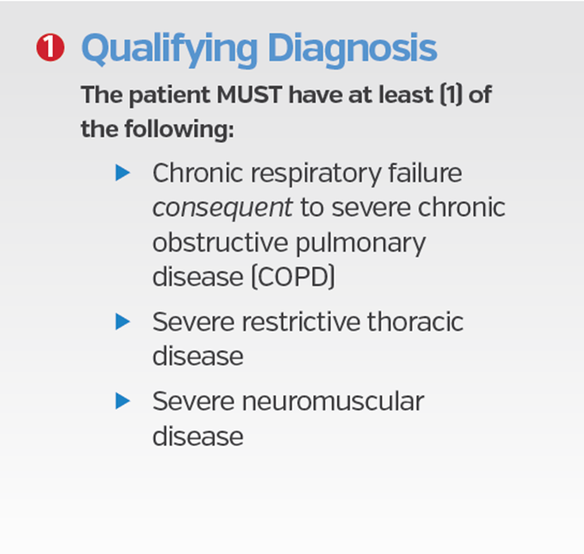
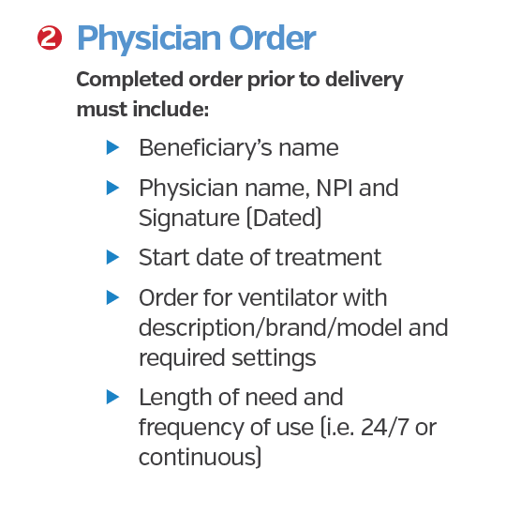
Qualification Criteria
Non-invasive ventilator HCPCS Code: E0466

Slide 25
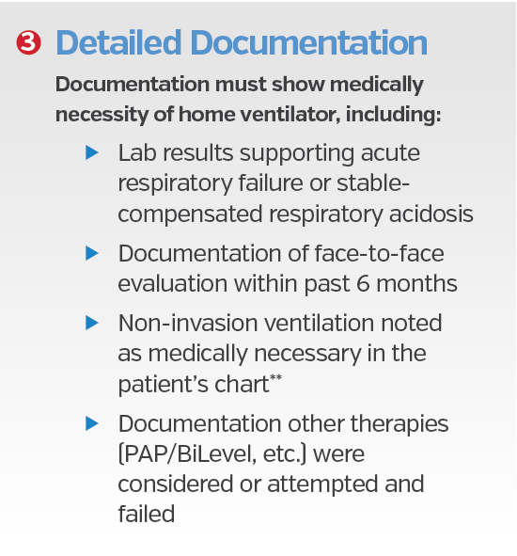
Qualification Criteria – Non-invasive ventilator HCPCS Code: E0466
Arterial Blood Gases prove chronic respiratory failure
FEV₁ To prove the staging of the disease
Comprehensive chart notes
The physician needs to tell the story why Trilogy versus lessor device
Notes:
I would like to introduce you to a new mode of NIV designed to treat all of your respiratory insufficiency patients in either the hospital or the home environments.
The three main components to AVAPS-AE are:
AVAPS, Average Volume Assured Pressure Support – A proven NIV algorithm that allows you to volume ventilate a patient noninvasively using a pressure support device.
Auto EPAP – Airway obstruction is an important factor when considering to noninvasively ventilate a patient. Philips Respironics has been treating patients diagnosed with airway obstructions with these algorithms for more than 20 years and now we are bringing it to you in a NIV device.
Auto backup rate – The auto backup rate allows the BiPAP A40 to determine the appropriate rate for the patient. The resulting rate is similar to what clinicians have been doing for years to determine an appropriate back-up rate for a patient.

Slide 26
Summary AVAPS-AE Average Volume Assured Pressure Support – AutoTitrating EPAP
AVAPS-AE is designed to better treat respiratory insufficiency patients (OHS, COPD and NMD) in the hospital and homecare environments
Proven performance of AVAPS
– Maintains targeted tidal volume COPD / OHS
Auto EPAP
– Maintains patent upper airway at comfortable pressure OSA
Auto backup rate
– Applies an auto backup rate near a patient’s resting rate COPD
Notes:
I would like to introduce you to a new mode of NIV designed to treat all of your respiratory insufficiency patients in either the hospital or the home environments.
The three main components to AVAPS-AE are:
AVAPS, Average Volume Assured Pressure Support – A proven NIV algorithm that allows you to volume ventilate a patient noninvasively using a pressure support device.
Auto EPAP – Airway obstruction is an important factor when considering to noninvasively ventilate a patient. Philips Respironics has been treating patients diagnosed with airway obstructions with these algorithms for more than 20 years and now we are bringing it to you in a NIV device.
Auto backup rate – The auto backup rate allows the BiPAP A40 to determine the appropriate rate for the patient. The resulting rate is similar to what clinicians have been doing for years to determine an appropriate back-up rate for a patient.

Slide 27
Thank You
Any questions?

