Slide 1
RESPIRATORY COMPROMISE:
Prevent the Preventable
Brian D. Berry Jr., RN, BSN, CRNA, MS, MBA
System Chief Nurse Anesthetist &
Director of Perioperative Services
Excela Health
Adjunct Faculty
University of Pittsburgh
Pittsburgh, PA
Notes:
Capnography and sepsis

Slide 2
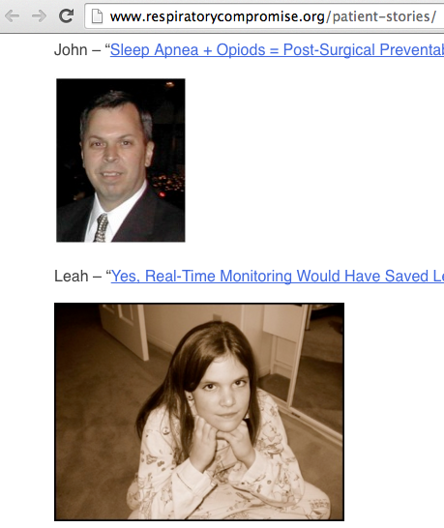
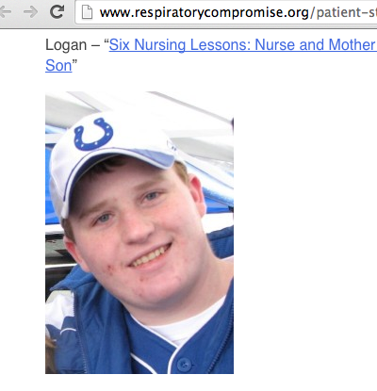
THE FACES OF RESPIRATORY COMPROMISE
Notes:
These are the faces of respiratory compromise. These individuals came into the hospital for routine procedures, but never made it home. Unfortunately, they represent a very small percentage of individuals who tragically lose their lives due to respiratory complications. Our whole goal this lecture is to prevent these tragedies from occurring at our facilities.

Slide 3
Lecture Objectives
Describe the impact of respiratory compromise from a cost as well as a morbidity and mortality perspective
Explain the difference between monitoring oxygenation and ventilation
Compare and contrast currently available monitoring techniques
Review evidence-based recommendations on the use of respiratory monitoring and the impact on preventing postoperative respiratory compromise

Slide 4
THE PROBLEM

Slide 5
What is Respiratory Compromise?
Respiratory Compromise is a state in which there is a high likelihood of decompensation into respiratory insufficiency, respiratory failure or death.
- The respiratory compromise institute¹
“I define respiratory compromise as a state of pre-respiratory failure…It's something that’s subtle. It's an early stage along a pathway of decline.”
  - Peter Marshall, MD
  Assistant Professor Yale University School of Medicine
1. http://www.respiratorycompromise.org/

Slide 6
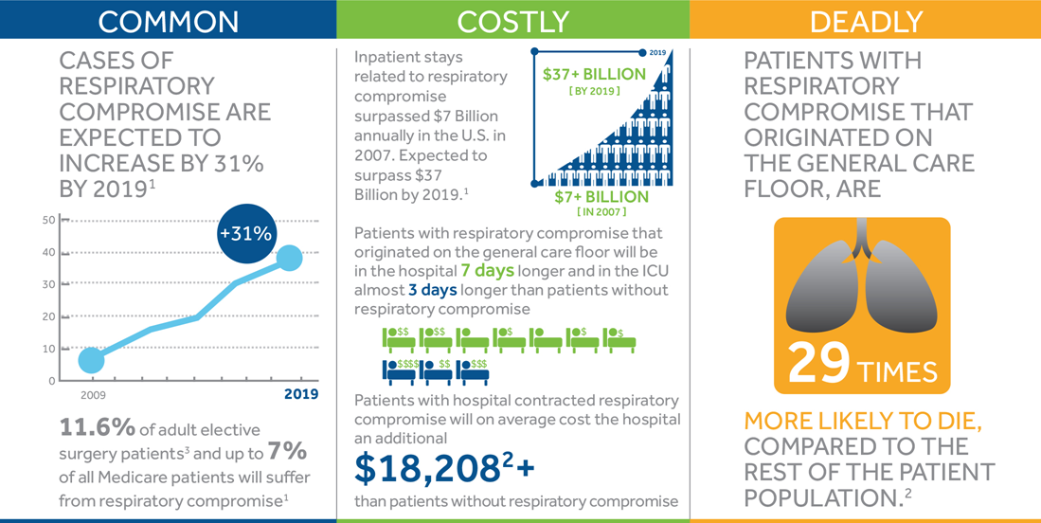
Up to 73% of in-hospital cardiopulmonary arrests were judged to be “potentially avoidable.” Clinical signs of deterioration in the preceding 24 h were not acted on in nearly half of cases. -Hodgetts, Resus 2002
Notes:
It is projected that RC costs will reach $39 billion annually by 2019, ranking in the AHRQ’s top 5 most rapidly increasing hospital costs. Patients that develop RC while on the General Care Floor have a mortality rate 29 times that of other patients. Currently, a standardized method of RC risk assessment with appropriate monitoring of those at increased risk does not exist.

Slide 7
RC by the Numbers
COMMON. COSTLY. DEADLY. PREVENTABLE.
2nd leading avoidable patient safety issue
3rd most common cause of avoidable deaths in the US
  Estimated 300,000-400,000 per year
3rd most rapidly increasing hospital inpatient cost in US
5th ranked condition leading to increasing hospital costs
Wier LM, Henke R, Friedman B. Diagnostic Groups with Rapidly Increasing Costs, by Payer, 2001-2007:
Statistical Brief #91. Healthcare Cost and Utilization Project (HCUP) Statistical Briefs. Rockville MD2010.
Notes:
Also note that 3- 400,000 deaths a year is equivalent to killing the population of any one of the following American cities: Tampa, Cincinnati, Honolulu, Wichita -every year

Slide 9
The Problem
77% records missing a vital sign¹¹
  Failure to recognize respiratory rate – least documented VS
Delayed interventions occur in 50% of patients with respiratory distress, with a median duration of delay of 12 hours.²
Higher risk for postop respiratory complications (PRC) = first 24 hours⁴
Early detection of RC
  Determines success of interventions³²
  Reduces rescue calls³
  Reduces ICU admissions³
Chen J, Hillman K, Bellomo R, et al. The impact of introducing medical emergency team system on the documentations of vital signs. Resuscitation. 2009;80:35-43.
Quach JL, Downey AW, Haase M, et al. Characteristics and outcomes of patients receiving a medical emergency team review for respiratory distress or hypotension. J Crit Care 2008;23:325-31.
Taenzer AH, Pyke JB, McGrath SP, Blike GT. Impact of pulse oximetry surveillance on rescue events and intensive care unit transfers: a before-and-after concurrence study. Anesthesiology. 2010;112:282-7
Taylor S, Kirton OC, Staff I, Kozol RA. Postoperative day one: a high risk period for respiratory events. Am J Surg. 2005;190(5):752-6
Notes:
Quach JL, Downey AW, Haase M, Haase-Fielitz A, Jones D, Bellomo R. Characteristics and outcomes of patients receiving a medical emergency team review for respiratory distress or hypotension. J Crit Care. 2008;23(3):325-331.

Slide 10
ETIOLOGY

Slide 11
Understanding Respiratory Anatomy and Physiology
FOUR events comprise respiration¹
Oxygenation and Ventilation
Gas Exchange
Gas Transport
Control of Ventilation
Guyton AC, Hall JE. Textbook of Medical Physiology. 11th ed. Philadelphia, PA: Elsevier Inc; 2006:471-522.

Slide 12


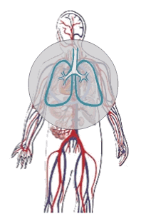



Oxygenation and Ventilation
  The process of getting O₂ into the body
etCO₂
Ventilation
Oxygenation
  The process of eliminating CO₂ from the body
SpO₂
2-separate physiologic processes
Image provided by Covidien
Notes:
The respiratory cycle is made up of two separate processes—oxygenation and ventilation. These two processes facilitate the transport of oxygen into and carbon dioxide out of the lungs; this is known as gas exchange. The efficiency of gas exchange is dependent on ventilation; the cyclical breathing movements that alternately move gas into and out of the lungs. Inspiration fills the lungs with oxygenated air; and expiration removes carbon dioxide.
Pulse Oximetry (SpO2) monitors oxygenation.
Oxygenation is the process of oxygen being inhaled into the lungs, dispersed by the alveoli to the blood, distributed to and metabolized by the cells of our muscles and organs.
Capnography monitors ventilation
CO2 is produced as a by-product of metabolism. It is transported by the vascular system from the cellular level to the lungs, where it is removed when we exhale. It is important to note that breathing is the primary method the body uses to regulate CO2. This is accomplished by the brain’s respiratory centers which send signals to regulate both respiration rate and depth. If CO2 is not regulated, a toxic accumulation in the blood can occur, resulting in respiratory failure.
<click>
Listed below are studies that support the statements on this slide:
Scanlan CL, Wilkins RL, Stoller JK. Egan’s Fundamentals of Respiratory Care, 8th Ed. St. Louis: Mosby; 2003.

Slide 13
Physiology of Oxygenation
98%–99% of O₂ total content is bound to Hb (SaO₂)
1%–2% of O₂ is dissolved in plasma (PaO₂)
  O₂ enters the tissues (PaO₂ gradient)
  Balance between SaO₂ and PaO2
  Hb in arterial blood remains 98% saturated (PaO₂ 95 mm Hg)
  Oxygen at tissues decline to 40 mm Hg (70%–75% Hb sat)
Normal PaO₂ = 80–100 mm Hg
Assessed by sampling of arterial blood gases (ABG)
Indirectly by noninvasive pulse oximetry (SpO₂)
Guyton AC, Hall JE. Textbook of Medical Physiology. 11th ed. Philadelphia, PA: Elsevier Inc; 2006:471-522.

Slide 14
Physiology of Ventilation
Ventilation
  Carbon Dioxide provides direct measurement of ventilation
70% transported as bicarbonate ion
23% bound to Hb (HbCO₂)
7% dissolved in blood (PaCO₂ 40 mm Hg)
Measure by invasively by ABG (PaCO₂)
  CO₂ + H₂0 <> H₂CO₃⁻ <> H⁺ + HC0₃⁻
While oxygenation may be normal, ventilation
can be inadequate
John Hall, Guyton and Hall Textbook of Medical Physiology. 12ed. 2010
Notes:
Although ventilation can be initiated voluntarily, it is largely under the control of the respiratory centers of the medulla where chemoreceptors respond to elevations in hydrogen ion concentration (pH) in the following manner: Carbon dioxide (CO2) diffuses from the blood to the cerebrospinal fluid in the brain and combines with water to form carbonic acid. The acid dissociates into bicarbonate and hydrogen ions (CO2 + H2O ↔ H2CO3 ↔ H+ + HCO3−). Although the chemoreceptors actually respond to hydrogen ions, the mechanism is referred to as hypercapnic drive because it is activated as serum carbon dioxide tensions elevate. The respiratory center can also be stimulated by neural impulses generated in the peripheral chemoreceptors of the aortic and carotid bodies. These receptors respond primarily to a decline in PaO2, and they are referred to as hypoxemic drive. Normally this mechanism assumes a secondary role to central hypercapnic drive, but assumes greater significance when central receptors become tolerant to elevated CO2 levels that occur with disorders such as chronic obstructive lung disease.

Slide 15
Gas Exchange and Transport
Secretions
Mucous Plug
A
E
V/Q
B
V/Q
C
D
Clot
Normal V/Q

Slide 16
Gas Exchange and Transport (Cont’d)
Tongue
Trachea
Soft palate
Uvula

Slide 17
Control of Ventilation
  Decreased cortical response―lower drive
  Loss of muscle tone
  Loss of airway patency
  Suppression of neural and muscular activity
  Reduced response to asphyxia
Branson RD. The scientific basis for postoperative respiratory care. Respir Care. 2013;58:1974-84.

Slide 18
Recognizing Respiratory Depression (RD)¹
RR < 10/min
Very shallow breathing (VT, VE)
Patient is unarousable or difficult to arouse
  RASS > -3²
SpO₂ < 90% for at least 30 seconds
ETCO2
Miaskowski C, Bair M, Chou R, et al. Principles of Analgesic Use in the Treatment of Acute Pain and Cancer Pain. 6th ed. Glenview, IL: American Pain Society; 2008.
Sessler CN, Gosnell MS, Grap MJ, et al. The Richmond Agitation-Sedation Scale: validity and reliability in adult intensive care unit patients. Am J Respir Crit Care Med. 2002;166:1338-44.
Notes:
Richmond Agitation Sedation Scale (RASS)
Sessler CN, Gosnell M, Grap MJ, Brophy GT, O'Neal PV, Keane KA, et al.
(2002). The Richmond Agitation-Sedation Scale: validity and reliability in adult
intensive care patients. Am J Respir Crit Care Med. 166, 1338-1344.

Slide 19
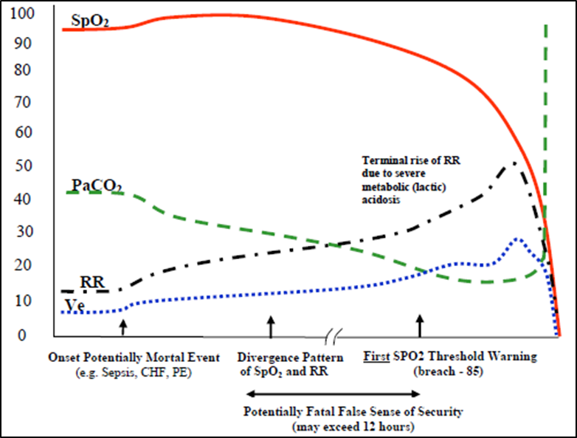
Hypoxemic Respiratory Failure (Type I)
Decreasing blood oxygen
Compensation by faster RR and increased minute volume, thus decreasing blood CO2
Due to plateau of oxyhemoglobin dissociation curve, SpO2 is maintained above 90% through a significant drop in PaO2
  Further masked by use of supplemental oxygen
Examples – pneumonia, asthma, sepsis, etc.
Lynn et al. Patterns of unexpected in-hospital deaths: a root
cause analysis. Safety in Surgery 2011, 5:3
http://www.pssjournal.com/content/5/1/3
Notes:
In their paper, “Patterns of unexpected in-hospital deaths: a root cause analysis”, Lynn and Curry demonstrate that despite the multitude of conditions and etiologies that can ultimately lead to respiratory failure, arrest, and death, there are 3 primary physiologic trends that manifest:
Hypoxemic Failure (Type I) is a pattern of comprised oxygenation leading to hyperventilation in an effort to compensate for declining blood oxygen levels. Initially, because of the plateau of the oxyhemoglobin dissociation curve, SpO2 is relatively well maintained during declining PaO2, while minute ventilation is increasing and PaCO2 is declining (Figure 1).

Slide 20
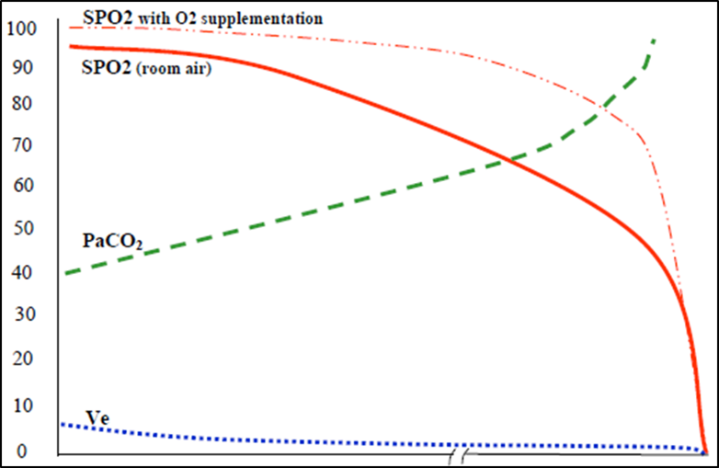
Hypercapnic Respiratory Failure (Type II)
Decreasing ventilation
  Decreased RR
  Decreased tidal volume
Results in increasing blood CO2 and drop in pH
Due to plateau of oxyhemoglobin dissociation curve, SpO2 is maintained above 90% through a significant rise in CO2
  Further masked by use of supplemental oxygen
Examples – Opioid use, brain center injury, sedation, etc.
Lynn et al. Patterns of unexpected in-hospital deaths: a root
cause analysis. Safety in Surgery 2011, 5:3
http://www.pssjournal.com/content/5/1/3
Notes:
Hypercapnic Failure (Type II) is a pattern of primary hypoventilation leading to elevations in arterial CO2 and subsequent drop in blood oxygen and SpO2. The drop in SpO2 is again delayed due to the plateau in the oxyhemoglobin dissociation curve and will be further masked if supplemental oxygen is in use as shown in Figure 2.

Slide 21
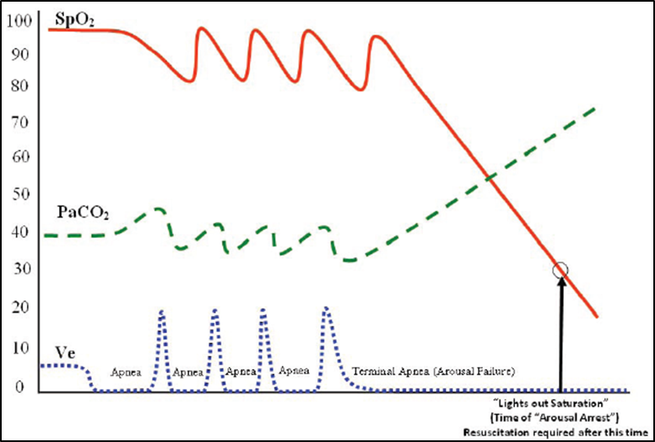
Arousal Failure (Type III)
Repetitive pattern of hypoventilation (apnea, hypopnea) followed by hyperventilation to restore normal blood oxygen/CO2 levels
Results in reciprocal sawtooth rises and falls in blood oxygen and CO2
Recovery response may be blunted by opioids, sedatives, alcohol, etc.
Examples – Obstructive sleep apnea, central sleep apnea, Cheyne-Stokes Respiration, etc.
Lynn et al. Patterns of unexpected in-hospital deaths: a root
cause analysis. Safety in Surgery 2011, 5:3
http://www.pssjournal.com/content/5/1/3
Notes:
Arousal Failure (Type III) is a pattern of repetitive reductions in airflow and SPO2, with corresponding but reciprocal cycles of increasing CO2 during sleep (or induced sleep such as sedation, analgesia) caused by instability of ventilation and/or upper airway control. Respiratory failure and death may occur when the patient has an arousal/recovery failure often exacerbated by sedating medications.

Slide 22
SOLUTIONS

Slide 23
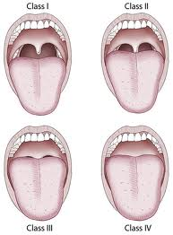
When to Monitor
Mallampati classification
Airway
Weight
Age
Polypharmacy
Comorbidities
http://emedicine.medscape.com/article/109695-overview#aw2aab6c11
“Unpredictable and Unidentifiable”
Notes:
Airway – Mallampti, Weight – obesity, Comorbidities (Cardiac, Respiratory, Gi Reflex)

Slide 24
When To Monitor
Compromise of
Respiratory Function
Moderate sedation
(conscious sedation)
Deep sedation
Analgesia
General anesthesia
Nagelhout et al., Nurse Anesthesia. 5th edition, St. Louis, Elsevier, 2014.

Slide 25
What to Monitor?
Para-meter | Monitoring Modality | Sensitivity | Specificity | Reliability | Response Time
CO2 | PaCO2 | High | High | High | Slow
 | etCO2 (intubated) | High | High | High | Fast
 | etCO2 (non-intubated) | High | Moderate-High | Moderate | Fast
 | Transcutan. tcCO2 | Moderate | High | Low-Moderate | Medium
O2 | SpO2 (no O2) | High | Moderate-High | High | Fast
 | SpO2 (w/ O2) | Moderate | Moderate | High | Slow
Indirect Measure of CO2 and/or O2 | Respiratory Rate | Moderate | Moderate | Moderate | Medium
 | Tidal Volume (unitubated) | Moderate | Moderate | Low | Medium
 | Skilled Clinician Assessment | Moderate | Moderate-High | Moderate | Slow
 | Unskilled Clinical Assessment | Low-Moderate | Low-Moderate | Low-Moderate | Slow
Adapted from Weinger APSF Fall 2011 Newsletter
Notes:
Monitoring Pathways to Failure/Death
In all 3 pathways, the defining parameters are trends of arterial oxygenation (PaO2) and CO2 levels (PaCO2). Arterial blood gases (ABGs) are traumatic to obtain, delayed in results, and provide only periodic ‘glimpses’ as continuous arterial measurement is not practical. For these reasons, continuous, non-invasive surrogates for these parameters are preferable. Pulse oximetry provides a practical measure of oxygenation but as illustrated above is a significantly lagging indicator of changes in ventilation. End-tidal CO2 (capnography) provides a breath-by-breath analysis of changes in ventilation patterns and CO2 levels. As shown in Table 1 from the Anesthesia Patient Safety Foundation’s “Essential Monitoring Strategies to Detect Clinically Significant Drug-Induced Respiratory Depression in the Postoperative Period” proceedings, end-tidal carbon dioxide (etCO2 or capnography) can be monitored in intubated and non-intubated patients with high sensitivity, fast response times, and moderately high specificity.
Other secondary measures of the adequacy of ventilation such as respiratory rate or minute ventilation may provide valuable information but do not provide a direct measure of CO2 levels. If a patient’s RR decreases to 6 or increases to 24, or if their minute ventilation decreases to 3 l/m or increases to 9 l/m, these are indications that the patients ventilation is changing but does not reveal their CO2 levels which is the primary measure of adequacy of ventilation.
Implications
While respiratory failure, arrest, and death may originate from a multitude of conditions, there are 3 trends of changes to arterial oxygen and carbon dioxide which provide clinicians with a significant window of opportunity for early identification and intervention. Early identification through continuous electronic monitoring of oxygen and carbon dioxide with appropriate intervention has the potential to allow reversal/mitigation of these trends resulting in several positive outcomes.
- Reduced complexity of intervention (e.g., change in medication versus intubation)
- Reduced disruption of clinician workflow (e.g., change made by nurse versus rapid response/code team)
- Improved reversibility/prognosis
- Improved patient outcomes
- Decreased LOS
- Decreased costs (e.g., reduction in intubation, ventilator support, ICU stays, etc.)
Respiratory Compromise is defined by changes in blood oxygen and carbon dioxide
Ideal monitoring is:
Direct measure of CO2 & O2
Continuous and non-invasive
Immediate notification
Reliable and specific
Not masked by supplemental oxygen use
Early identification and intervention key to mitigate decline
Delays in recognition leads to more complex intervention, greater disruption of workflow, decreased reversibility, and poorer clinical/ economic outcomes

Slide 26
Carbon Dioxide
TRUE MEASURE OF VENTILATION
  Patient may be well oxygenated
  VT (≈ 500 mL) vs. FRC (≈ 2400 mL = O₂ reserve)
    VT - Tidal Volume FRC - Functional Residual Capacity
  Apnea : O₂ reserve continues diffusion into pulmonary capillaries : principle behind pre-oxygenation
  Time from apnea to hypoxemia depends on FRC (age, size, medical condition)
John Hall, Guyton and Hall Textbook of Medical Physiology. 12ed. 2010
Notes:
The volume of gas inspired and expired during a normal ventilatory cycle is called tidal volume and averages 500 mL or 6–8 mL/kg of ideal body weight. This is far less than the total amount of gas normally found in the respiratory passages. Functional residual capacity reflects the volume of gas remaining in the lungs at the end of tidal respiration and approximates 2400 mL. The oxygen content of the gas mixture in the functional residual capacity can be viewed as oxygen reserve. If ventilation ceases, oxygen in this reserve continues to diffuse into the pulmonary capillaries. Therefore, the time from onset of apnea until hypoxemia ensues is a function of the oxygen concentration found in the functional residual capacity. This is the basis for preoxygenating a patient prior to the induction of general anesthesia, neuromuscular blockade, or tracheal intubation, as well as oxygen supplementation during sedation and general anesthesia. By increasing the oxygen content of the functional residual capacity, more time will be available for appropriate intervention if hypoventilation or apnea occurs. This time varies because functional residual capacity differs according to the age, size, and medical status of the patient

Slide 27
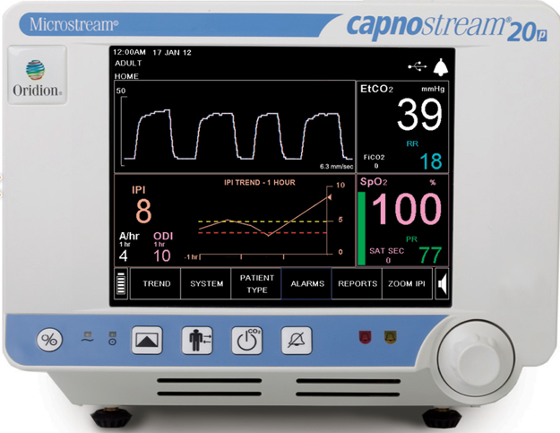
Oxygenation vs. Ventilation
Now hold your breath...
What happens to the waveforms?
EtCO₂
SpO₂
How long will it take the SpO₂ to drop below 90%?
How long will it take the EtCO₂ waveform to go flat line?
Notes:
Now hold your breath.
Note what happens to the two waveforms.
How long did it take the EtCO₂ wave form to go flat line?
How long did it take the SpO₂ to drop below 90%?
Teaching Note: Have someone use a stop watch to clock the time differences. Ask class members about the impact that this time difference may have on the care of a patient in respiratory distress.

Slide 28
CO₂ Monitoring: Terminology
Capnometry
Numeric value of
etCO₂ only
A Capnometer provides only a number for CO₂ measurement
Capnogram
Waveform tracing of CO₂ over time
A Capnograph provides a waveform called
a “capnogram”
Capnography
Ventilation rate +
quality + a waveform
Capnography provides an etCO_{2,} a respiration rate, & capnogram
Images provided by Restrepo
Notes:
As we begin this module, it is important to understand the difference between some key terms. The first term “Capnometry” describes the numerical measurement of the concentration of CO2 in exhaled breath. This numerical measurement is obtained by a device called a Capnometer.
The second term is "capnogram“. Capnogram refers to the graphical representation of the concentration of inhaled and exhaled CO2. This type of graph is referred to as a waveform. A capnogram is obtained by a capnograph.
Both the numerical measurement and capnogram are necessary in order to provide a complete picture of the patient’s ventilation for clinical evaluation. The word “Capnography” refers to a device which provides both the numeric end tidal CO2 value, a respiration rate and a capnogram or waveform.
You will discover the importance of this information as we discuss the new AHA Guidelines, in that their recommendations specify waveform capnography, which cannot be obtained by a capnometer.
<click>

Slide 29
Capnography
Slow respirations – opioid / sedative effect
Shallow, irregular breathing – partial airway obstruction (OSA)
Rebreathing
Apnea, agonal breathing
Graphs provided by R. Restrepo

Slide 30
THE LITERATURE

Slide 31
Capnographic Monitoring and its Effects on Safety of Sedation
N = 247 undergoing endoscopic retrograde cholangiopancreatography (ERCP) with opioid and benzodiazepine
Randomized
  Study arm: team blinded to capnography
  Open arm: team was prompted of capnographic changes
Primary endpoint: occurrence of hypoxemia
Qadeer MA, Vargo JJ, Dumot JA, et al. Capnographic monitoring of respiratory activity improves safety of sedation for endoscopic cholangiopancreatography and ultrasonography. Gastroenterology. 2009;136(5):1568-76.
Notes:
Gastroenterology. 2009 May;136(5):1568-76; quiz 1819-20.
Capnographic monitoring of respiratory activity improves safety of sedation for endoscopic cholangiopancreatography and ultrasonography.
Qadeer MA, Vargo JJ, Dumot JA, Lopez R, Trolli PA, Stevens T, Parsi MA, Sanaka MR, Zuccaro G.
Source Department of Gastroenterology and Hepatology, Digestive Disease Institute, Cleveland Clinic Foundation, Cleveland, Ohio 44195, USA.
BACKGROUND & AIMS:
The Joint Commission on the Accreditation of Healthcare Organizations recommends ventilation monitoring during procedural sedation for gastrointestinal endoscopy. We sought to determine whether intervention, based on a microstream capnography-based ventilation monitoring system that has been shown to function as an early warning system for hypoxemia, would decrease hypoxemia during endoscopy.
METHODS:
Subjects undergoing elective endoscopic retrograde cholangiopancreatography (ERCP) and endoscopic ultrasonography (EUS) under procedural sedation with a combination of opioid and benzodiazepine were randomly assigned to either a study arm in which the endoscopy team was blinded to capnography or an open arm in which the endoscopy team was prompted of capnographic changes. The primary end point was the occurrence of hypoxemia; secondary end points were the occurrences of severe hypoxemia, apnea, and oxygen supplementation.
RESULTS:
A total of 263 subjects were enrolled; 247 were analyzed for efficacy. The numbers of hypoxemic events in the blinded and open arms were 132 and 69, respectively (P < .001). Thirty-five percent of all hypoxemic events occurred with completely normal ventilation. Hypoxemia developed in 69% of patients in the blinded arm compared with 46% in the open arm (P < .001). Severe hypoxemia percentages in the blinded and open arms were 31% and 15% (P = .004), for apnea were 63% and 41% (P < .001), for oxygen supplementation were 67% and 52% (P = .02), and for recurrent hypoxemia after oxygen supplementation were 38% and 18% (P = .01), respectively.
CONCLUSIONS:
Capnographic monitoring of respiratory activity improves patient safety during procedural sedation for elective ERCP/EUS by reducing the frequency of hypoxemia, severe hypoxemia, and apnea.

Slide 32
Capnographic Monitoring and its Effects on Safety of Sedation (cont’d)
RESULTS
1, 3 p < .001
2 p = .004
4 p = .02
5 p = .01
GROUP | Hypoxemic Events¹ | Severe Hypoxemia² | Apnea³ | O₂ Supplementation⁴ | Recurrent hypoxemia after O₂ Supple-mentation⁵
Blinded | 132 | 31% | 63% | 67% | 38%
Open | 69 | 15% | 41% | 52% | 18%
Qadeer MA, Vargo JJ, Dumot JA, et al. Capnographic monitoring of respiratory activity improves safety of sedation for endoscopic cholangiopancreatography and ultrasonography. Gastroenterology. 2009;136(5):1568-76.
Notes:
Gastroenterology. 2009 May;136(5):1568-76; quiz 1819-20.
Capnographic monitoring of respiratory activity improves safety of sedation for endoscopic cholangiopancreatography and ultrasonography.
Qadeer MA, Vargo JJ, Dumot JA, Lopez R, Trolli PA, Stevens T, Parsi MA, Sanaka MR, Zuccaro G.
Source Department of Gastroenterology and Hepatology, Digestive Disease Institute, Cleveland Clinic Foundation, Cleveland, Ohio 44195, USA.
BACKGROUND & AIMS:
The Joint Commission on the Accreditation of Healthcare Organizations recommends ventilation monitoring during procedural sedation for gastrointestinal endoscopy. We sought to determine whether intervention, based on a microstream capnography-based ventilation monitoring system that has been shown to function as an early warning system for hypoxemia, would decrease hypoxemia during endoscopy.
METHODS:
Subjects undergoing elective endoscopic retrograde cholangiopancreatography (ERCP) and endoscopic ultrasonography (EUS) under procedural sedation with a combination of opioid and benzodiazepine were randomly assigned to either a study arm in which the endoscopy team was blinded to capnography or an open arm in which the endoscopy team was prompted of capnographic changes. The primary end point was the occurrence of hypoxemia; secondary end points were the occurrences of severe hypoxemia, apnea, and oxygen supplementation.
RESULTS:
A total of 263 subjects were enrolled; 247 were analyzed for efficacy. The numbers of hypoxemic events in the blinded and open arms were 132 and 69, respectively (P < .001). Thirty-five percent of all hypoxemic events occurred with completely normal ventilation. Hypoxemia developed in 69% of patients in the blinded arm compared with 46% in the open arm (P < .001). Severe hypoxemia percentages in the blinded and open arms were 31% and 15% (P = .004), for apnea were 63% and 41% (P < .001), for oxygen supplementation were 67% and 52% (P = .02), and for recurrent hypoxemia after oxygen supplementation were 38% and 18% (P = .01), respectively.
CONCLUSIONS:
Capnographic monitoring of respiratory activity improves patient safety during procedural sedation for elective ERCP/EUS by reducing the frequency of hypoxemia, severe hypoxemia, and apnea.

Slide 33
Microstream® Capnography and Patient Monitoring During Moderate Sedation
Randomized, controlled trial
163 children ― 174 elective GI procedures with moderate sedation in a pediatric endoscopy unit
NC 2 LPM
Blinded to microstream capnography monitoring
Alveolar hypoventilation (AH) signaled
  Blinded arm: if > 15 sec: trained observers informed clinical staff
  Open/control arm: If > 60 sec
Primary outcome: SpO₂ < 95% for > 5 sec
Lightdale JR, Goldmann DA, Feldman HA, et al. Microstream capnography improves patient monitoring during moderate sedation: a randomized, controlled trial. Pediatrics. 2006;117(6):e1170-8.
^{®Microstream is a} trademark of a Covidien company. Registered in the US and foreign countries.
Notes:
Pediatrics. 2006 Jun;117(6):e1170-8. Epub 2006 May 15.
Microstream capnography improves patient monitoring during moderate sedation: a randomized, controlled trial.
Lightdale JR, Goldmann DA, Feldman HA, Newburg AR, DiNardo JA, Fox VL.
Source
Children's Hospital Boston, Boston, Massachusetts 02115, USA. jenifer.lightdale@childrens.harvard.edu
Abstract
BACKGROUND:
Investigative efforts to improve monitoring during sedation for patients of all ages are part of a national agenda for patient safety. According to the Institute of Medicine, recent technological advances in patient monitoring have contributed to substantially decreased mortality for people receiving general anesthesia in operating room settings. Patient safety has not been similarly targeted for the several million children annually in the United States who receive moderate sedation without endotracheal intubation. Critical event analyses have documented that hypoxemia secondary to depressed respiratory activity is a principal risk factor for near misses and death in this population. Current guidelines for monitoring patient safety during moderate sedation in children call for continuous pulse oximetry and visual assessment, which may not detect alveolar hypoventilation until arterial oxygen desaturation has occurred. Microstream capnography may provide an "early warning system" by generating real-time waveforms of respiratory activity in nonintubated patients.
OBJECTIVE:
The aim of this study was to determine whether intervention based on capnography indications of alveolar hypoventilation reduces the incidence of arterial oxygen desaturation in nonintubated children receiving moderate sedation for nonsurgical procedures.
PARTICIPANTS AND METHODS:
We included 163 children undergoing 174 elective gastrointestinal procedures with moderate sedation in a pediatric endoscopy unit in a randomized, controlled trial. All of the patients received routine care, including 2-L supplemental oxygen via nasal cannula. Investigators, patients, and endoscopy staff were blinded to additional capnography monitoring. In the intervention arm, trained independent observers signaled to clinical staff if capnograms indicated alveolar hypoventilation for >15 seconds. In the control arm, observers signaled if capnograms indicated alveolar hypoventilation for >60 seconds. Endoscopy nurses responded to signals in both arms by encouraging patients to breathe deeply, even if routine patient monitoring did not indicate a change in respiratory status.
OUTCOME MEASURES:
Our primary outcome measure was patient arterial oxygen desaturation defined as a pulse oximetry reading of <95% for >5 seconds. Secondary outcome measures included documented assessments of abnormal ventilation, termination of the procedure secondary to concerns for patient safety, as well as other more rare adverse events including need for bag-mask ventilation, sedation reversal, or seizures.
RESULTS:
Children randomly assigned to the intervention arm were significantly less likely to experience arterial oxygen desaturation than children in the control arm. Two study patients had documented adverse events, with no procedures terminated for patient safety concerns. Intervention and control patients did not differ in baseline characteristics. Endoscopy staff documented poor ventilation in 3% of all procedures and no apnea. Capnography indicated alveolar hypoventilation during 56% of procedures and apnea during 24%. We found no change in magnitude or statistical significance of the intervention effect when we adjusted the analysis for age, sedative dose, or other covariates.
CONCLUSIONS:
The results of this controlled effectiveness trial support routine use of microstream capnography to detect alveolar hypoventilation and reduce hypoxemia during procedural sedation in children. In addition, capnography allowed early detection of arterial oxygen desaturation because of alveolar hypoventilation in the presence of supplemental oxygen. The current standard of care for monitoring all patients receiving sedation relies overtly on pulse oximetry, which does not measure ventilation. Most medical societies and regulatory organizations consider moderate sedation to be safe but also acknowledge serious associated risks, including suboptimal ventilation, airway obstruction, apnea, hypoxemia, hypoxia, and cardiopulmonary arrest. The results of this controlled trial suggest that microstream capnography improves the current standard of care for monitoring sedated children by allowing early detection of respiratory compromise, prompting intervention to minimize hypoxemia. Integrating capnography into patient monitoring protocols may ultimately improve the safety of nonintubated patients receiving moderate sedation.

Slide 34
Microstream Capnography and Patient Monitoring (cont’d)
RESULTS
Endoscopy staff documented poor ventilation in 3% of all procedures and no apnea.
Intervention arm
  Less likely to experience low SpO₂
  Capnography indicated AH during 56% of procedures and apnea during 24%
  Early detection of desaturation due to AH despite use of routine O₂
Lightdale JR, Goldmann DA, Feldman HA, et al. Microstream capnography improves patient monitoring during moderate sedation: a randomized, controlled trial. Pediatrics. 2006;117(6):e1170-8.
Notes:
Pediatrics. 2006 Jun;117(6):e1170-8. Epub 2006 May 15.
Microstream capnography improves patient monitoring during moderate sedation: a randomized, controlled trial.
Lightdale JR, Goldmann DA, Feldman HA, Newburg AR, DiNardo JA, Fox VL.
Source
Children's Hospital Boston, Boston, Massachusetts 02115, USA. jenifer.lightdale@childrens.harvard.edu
Abstract
BACKGROUND:
Investigative efforts to improve monitoring during sedation for patients of all ages are part of a national agenda for patient safety. According to the Institute of Medicine, recent technological advances in patient monitoring have contributed to substantially decreased mortality for people receiving general anesthesia in operating room settings. Patient safety has not been similarly targeted for the several million children annually in the United States who receive moderate sedation without endotracheal intubation. Critical event analyses have documented that hypoxemia secondary to depressed respiratory activity is a principal risk factor for near misses and death in this population. Current guidelines for monitoring patient safety during moderate sedation in children call for continuous pulse oximetry and visual assessment, which may not detect alveolar hypoventilation until arterial oxygen desaturation has occurred. Microstream capnography may provide an "early warning system" by generating real-time waveforms of respiratory activity in nonintubated patients.
OBJECTIVE:
The aim of this study was to determine whether intervention based on capnography indications of alveolar hypoventilation reduces the incidence of arterial oxygen desaturation in nonintubated children receiving moderate sedation for nonsurgical procedures.
PARTICIPANTS AND METHODS:
We included 163 children undergoing 174 elective gastrointestinal procedures with moderate sedation in a pediatric endoscopy unit in a randomized, controlled trial. All of the patients received routine care, including 2-L supplemental oxygen via nasal cannula. Investigators, patients, and endoscopy staff were blinded to additional capnography monitoring. In the intervention arm, trained independent observers signaled to clinical staff if capnograms indicated alveolar hypoventilation for >15 seconds. In the control arm, observers signaled if capnograms indicated alveolar hypoventilation for >60 seconds. Endoscopy nurses responded to signals in both arms by encouraging patients to breathe deeply, even if routine patient monitoring did not indicate a change in respiratory status.
OUTCOME MEASURES:
Our primary outcome measure was patient arterial oxygen desaturation defined as a pulse oximetry reading of <95% for >5 seconds. Secondary outcome measures included documented assessments of abnormal ventilation, termination of the procedure secondary to concerns for patient safety, as well as other more rare adverse events including need for bag-mask ventilation, sedation reversal, or seizures.
RESULTS:
Children randomly assigned to the intervention arm were significantly less likely to experience arterial oxygen desaturation than children in the control arm. Two study patients had documented adverse events, with no procedures terminated for patient safety concerns. Intervention and control patients did not differ in baseline characteristics. Endoscopy staff documented poor ventilation in 3% of all procedures and no apnea. Capnography indicated alveolar hypoventilation during 56% of procedures and apnea during 24%. We found no change in magnitude or statistical significance of the intervention effect when we adjusted the analysis for age, sedative dose, or other covariates.
CONCLUSIONS:
The results of this controlled effectiveness trial support routine use of microstream capnography to detect alveolar hypoventilation and reduce hypoxemia during procedural sedation in children. In addition, capnography allowed early detection of arterial oxygen desaturation because of alveolar hypoventilation in the presence of supplemental oxygen. The current standard of care for monitoring all patients receiving sedation relies overtly on pulse oximetry, which does not measure ventilation. Most medical societies and regulatory organizations consider moderate sedation to be safe but also acknowledge serious associated risks, including suboptimal ventilation, airway obstruction, apnea, hypoxemia, hypoxia, and cardiopulmonary arrest. The results of this controlled trial suggest that microstream capnography improves the current standard of care for monitoring sedated children by allowing early detection of respiratory compromise, prompting intervention to minimize hypoxemia. Integrating capnography into patient monitoring protocols may ultimately improve the safety of nonintubated patients receiving moderate sedation.

Slide 35
Respiratory Therapists and Pain Management Using
End Tidal CO₂ Monitoring
In 2007, prior to implementing a postop program including capnography monitoring:
  19.6% of Adverse drug events (ADEs) rated as severe and 16.7% of moderate/severe ADEs progressed to code blue
From Jan – June 2011:
  2% of ADEs were categorized as severe and zero moderate/severe ADEs progressed to code blue.
Fox D. Integral role of respiratory therapists in a comprehensive pain management program using end tidal CO2 monitoring. ARC Congress 2011. Open Forum #16. Tampa, FL; November 8, 2011.
Notes:
Fox D, Wencel M. Integral role of respiratory therapists in a comprehensive pain management program using end tidal CO2 monitoring..
Respir Care. 2011;56(12):1706

Slide 36
ETCO₂ Monitoring in the ED
Methods: Treating physicians administering procedural sedation were randomized to have access to capnography monitoring or blinded to the monitored capnography measurements.
Results:
  ETCO² Group – 25% of patients had hypoxia
  Blinded Group – 42% of patients had hypoxia
  Capnography recognized all cases of hypoxia before onset (100% sensitivity)
    ETCO₂ triggered intervention 60 sec before onset of hypoxia
Deitch et al Ann Emerg Med. 2010 Mar;55(3):258-64. doi: 10.1016/

Slide 37
Capnography & Oximetry in PCA pts
58%
Resp Depression
2 min longer, low RR < 10 bpm
41%
Resp Depression
3 min longer, low RR < 10 bpm
ETCO₂
12%
Resp Depression
SpO2 <90%
Traditional
Conservative
SpO2
178 PCA patients
Overdyk et al. Continuous oximetry /capnometry monitoring reveals fequent desaturation
and bradypnea during patient controlled analgesia. Anesth and Analg 2007, 105. 412-8.
Notes:
In another similar study etco2 monitoring alerted nurses 2 hrs before spo2!!!

Slide 38
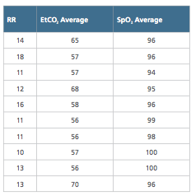
What is missing with continuous SpO₂?
(pulse oximeter with RR)
SpO₂ values of patients receiving oxygen by nasal cannula
Threshold alarm
Bradypnea (RR<8-10)
Hypoxia (SpO₂ < 90%)
Overdyk F et. al,. Continuous oximetry/capnometry monitoring reveals frequent desaturation and bradypnea during patient-controlled analgesia. A&A 2007:105;412-18.
Notes:
Some examples of actual values of patients monitored with both pulse oximetry and capnography on opioids and receiving supplemental oxygen.
Note none of these values would trigger a RRT call.
But if you look at the ETCO2 values, you get a different picture.

Slide 39
Capnography as a diagnostic indicator
06 Surviving Sepsis Campaign. Updated Bundles in Response to New Evidence. http://www.survivingsepsis.org/Bundles/Pages/default.aspx
Notes:
The 2012 Surviving Sepsis Campaign Guidelines Point out that to be completed in 3 hours is to measure a lactate level. Suggest that evidence shows that this can be substituted with a capnography reading. This saves time and money, provides for rapid triage and earlier recognition and treatment of patients with sepsis or at risk for sepsis.
For the rest, use the Hunter article.
http://www.survivingsepsis.org/Bundles/Pages/default.aspx

Slide 40
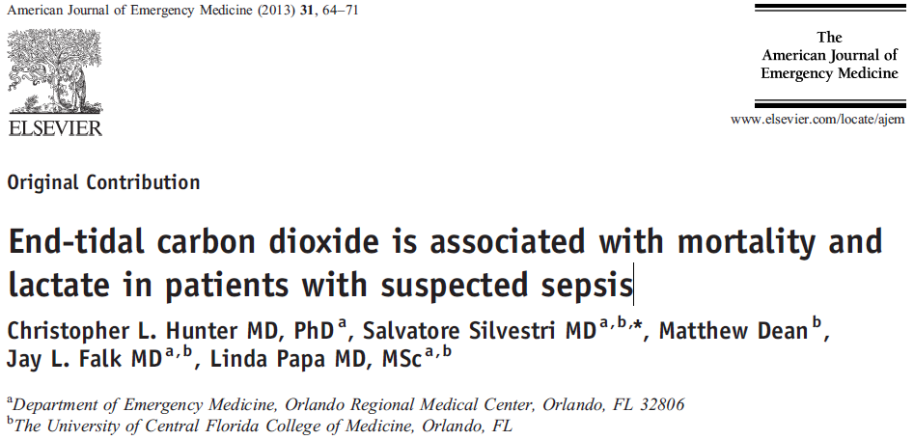
Capnography as a diagnostic indicator for Sepsis
Suggests that etCO2 concentration may perform similarly to lactate levels as a
predictor for mortality in patients with suspected sepsis.
ETCO2 among the 3 (etCO2, vasopressors, mechanical ventilation) independent
predictors of mortality.
08 Hunter CL, Silvestri S, Dean M, Falk JL, Papa L. End-tidal carbon dioxide is associated with mortality and lactate in patients with suspected sepsis. The American Journal of Emergency Medicine. 2013;31(1):64-71.
Notes:
Hunter:Exhaled end-tidal carbon dioxide (ETCO2) concentration is associated with lactate levels in febrile patients. We assessed the association of ETCO2 with mortality and lactate levels in patients with suspected sepsis.
We observed a significant association between ETCO2 concentration and in-hospital mortality in emergency department patients with suspected sepsis across a range of disease severity.
Severe sepsis and septic shock are responsible for significant morbidity and mortality among patients admitted to the emergency department (ED) [1]. Early identification and treatment of these disorders have been shown to improve survival [2,3]. A hallmark of septic shock is hypoperfusion leading to end-organ damage and cardiovascular collapse [1,4]. Lactic acidosis is a well-accepted marker for disease severity in this population [4,5] and has been shown to predict mortality in ED patients with infection
This study suggests that ETCO2 concentration may perform similarly to lactate levels as a predictor for mortality in patients with suspected sepsis. This performance was comparable across sepsis categories, as well as in both spontaneously breathing patients and those who required emergent intubation upon presentation to the ED. Further- more, when we controlled for potential predictors of mortality, such as age, use of pressors, admission to the ICU, mechanical ventilation, positive blood cultures, and lactate levels, ETCO2 was among the 3 (ETCO2, vasopressors, mechanical ventilation) independent predictors of mortality.

Slide 41
PRODIGY STUDY
OIRD common on general care floor
No tool to reliably predict OIRD
SOLUTION…
  Create and validate a risk prediction tool for RD on general care floors using continuous respiratory monitoring
  1650 patients from 16 centers from 7 different countries
Khanna AK, Overdyk FJ, Greening C, Di Stefano P, Buhre WF JOURNAL J of Crit Care 2018,

Slide 42
Cost Saving
Prevented 471 ADEs
Per IOM $8,750/ per ADE
Saved $3,970,260
(not considering litigation)
Hospital System over
5 yr period.
Maddox et al., Anes Patient Saftey Foundation. Newsletter. Winter 2012.
Notes:
2 hospital system in Savannah GA had 2 yrs of serious events patients resp distress. Implemented etco2 on patients with PCAs. Concluded etco2 is best and earliest predictor

Slide 43
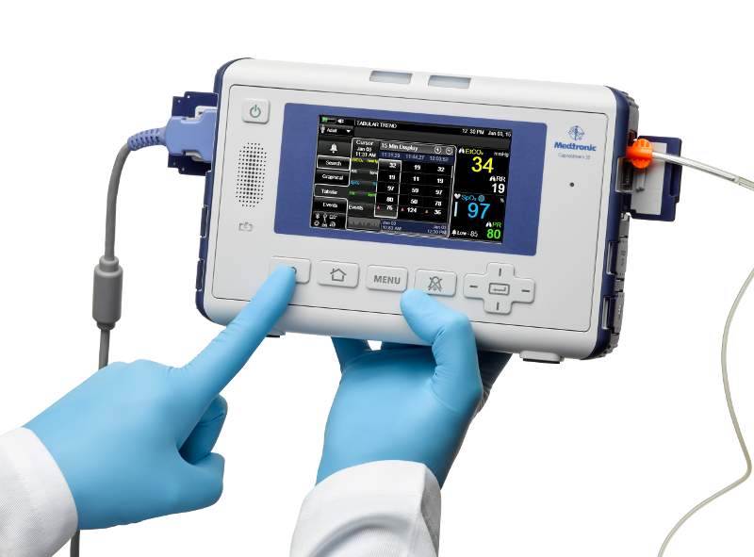
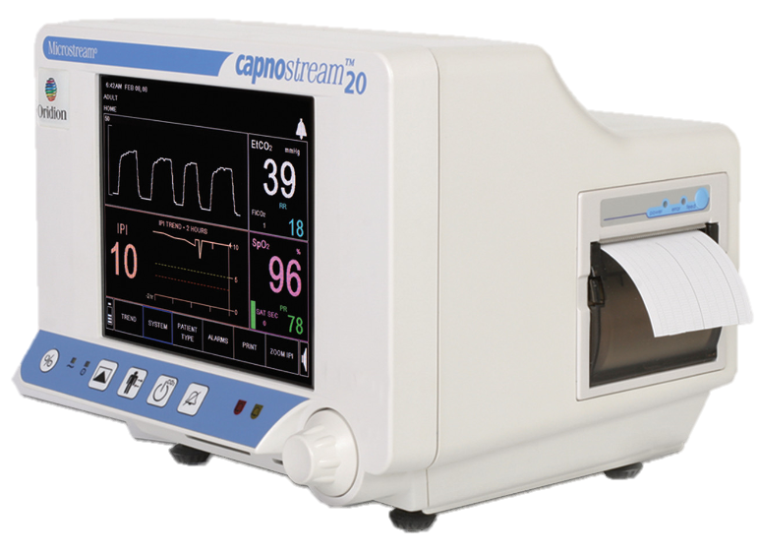
http://www.covidien.com

Slide 44
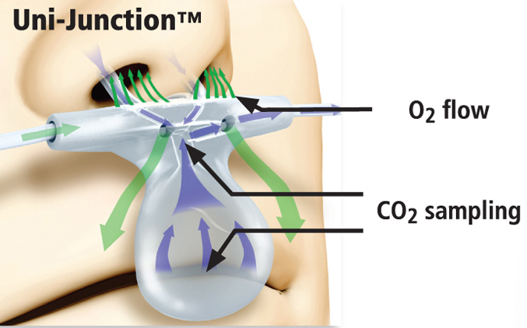
Capnography
Can accommodate mouth breathers (nasal and mouth sampling)
Minimally disruptive in awake and sleeping patients
Engineered with technology to enhance waveform integrity accuracy
http://www.covidien.com

Slide 45
SpO₂ plus EtCO₂
PCA patients
  65% reduction in overall adverse effects and cost
Obstacles to implementation
  Alarm fatigue (95% of hospitals surveyed)
  Single monitor preferred (71%)
Wong M, Mabuyi A, Gonzalez B. First national survey of patient-controlled analgesia practices. Physician-Patient Alliance for Health and Safety. 2013.

Slide 46
Important but Different Measurements
etCO2
Reflects alveolar ventilation
AH and apnea detected immediately
SpO2
Reflects oxygenation
Values lag with AH and apnea
“Cases of respiratory depression were 28 times as likely to be detected, if they were monitored by capnography, as those who were not monitored.”
“… end tidal carbon dioxide monitoring is an important addition to oximetry for detecting respiratory depression.”
Waugh JB, Epps CA, Khodneva Y. Capnography enhances surveillance of respiratory events during procedural sedation: a meta-analysis. Journal of Clinical Anesthesia May 2011;23(3):189-96.

Slide 47
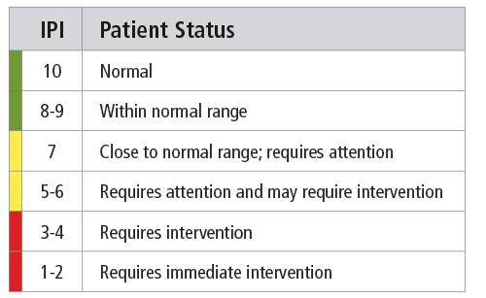
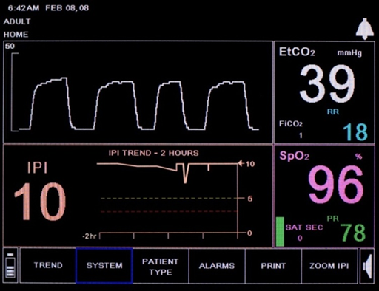
Integrated Pulmonary Index
Integrated Pulmonary Index Value: 10 is good, 1 is not

Slide 48
Respiratory compromise: a dangerous cascade
RISK
INSUFFICIENCY
FAILURE
ARREST
DEATH
Risk Factors
Disease
Age
Comorbidities
Procedures
Medication
Movement
Care setting
  Patient is in respiratory distress
  Decreased respiratory rate
  Decreased spO₂
  Reduced exhaled CO₂
  Reduced end-tidal or etCO₂
Vitals indicate patient is not breathing and perfusion is rapidly declining
Patient requires resuscitation
High workflow disruption
Complex interventions
Increasing costs
Deteriorating outcomes / prognosis
PREVENTION / MONITORING / DETECTION

Slide 49
Growing Wave of Capnography
2011
2012
2013
2014
2015
2016
BRCA/DAS
Airway
BRCA/BSG
Sedation
AARC
Mechanical Ventilation
‘96 minute Man’
Resuscitation
AAGBI
Sedation/ ICU
EBA
Sedation/ICU
ASA
Sedation
APSF
Opioids
CAS
Sedation
ICS
ICU
NHI
Sedation
IHI
Sedation/Narcotics
BRCA/CEM
Sedation
BRCEM
Sedation
AAOMS
Sedation
TJC
Opioids
AAAHC IQI
Sedation
AANA
Sedation
CMS
PCA
ASA
Airway
AAGBI X 2
Airway/PACU
AHA
Resuscitation
SIR
Sedation
ARMC
Sedation
ECRI
Opioids
CMS NYSPFP
Opioids
CDC
Opioids
USAF
Sedation
ACEP/ENA
Sedation
NICE
Sedation
EBA
Sedation/PACU/Transfer
BRCA/CEM
Sedation
TennCare
SNF Ventilators
CMS Memo
Opioids
CSANZ
Sedation
ECRI
Opioids
SGNA
Sedation
ICS
ICU
ASA X 2
Sedation
CMQ/OPIQ/OIIQ
Sedation
CSGNA
Sedation
SIR
Sedation
BCS/BHRS
Sedation
BRCA
Sedation/ICU/ED
ESGE/ESGENA
Sedation
CICMANZ/ANZCA/
ACEM
Transport
RCI
Respiratory Compromise
SHM
Opioids
DAS
Airway
AHA/ERC
Resuscitation
ICS
Airway
SPS
Sedation
ANZCOR
Resuscitation
AAGBI/EBA
Anesthesia/Sedation
AORN
Sedation
ARIN
Sedation
APS
Opioids
ASA
Opioids
Swedish Guidelines
Sedation
RCEM
Sedation
AAP/AAPD
Sedation
SCAI/SPA/CCAS
Sedation
(2017-2018)
TennCare - SNF Ventilation
ECRI Top 10 Technology Hazards
ECRI Top 10 Pt Safety Concerns
EBA/ESA – Procedural Sedation
PPAHS - Opioids
US/N American
Europe
Australasian
Notes:
Since 2010, there has been 90 standards, position statements, or recommendations regarding the use of capnography monitoring. Average 11/yr

Slide 50
QUESTIONS?

